Slide 1

Skills 2 propel
‘Building Stronger Leaders, Building stronger Businesses!’
15th October 2026

Slide 2


WELCOME
Marc McGerty
Causeway Coast and Glens Labour Market Partnership

Slide 3
Agenda
9.30am - Deputy Mayor, Alderman Sandra Hunter
9.35am - Labour Market Partnership Overview, Marc McGerty
9.45am - Employer Case Study
  Kelly Crosskey - Platinum Care
  Declan Hassan - Moore NI
10.15am - Leadership and Management Development Skills Funding and Support
  Invest NI Leadership Team Programme (Catherine McGuigan)
  Apprenticeships and Higher Level Apprenticeships (Katie Devenney DfE)
  Other Support (Marc McGerty)
QUESTIONS
10.45am Networking and Skills Exhibitors

Slide 4
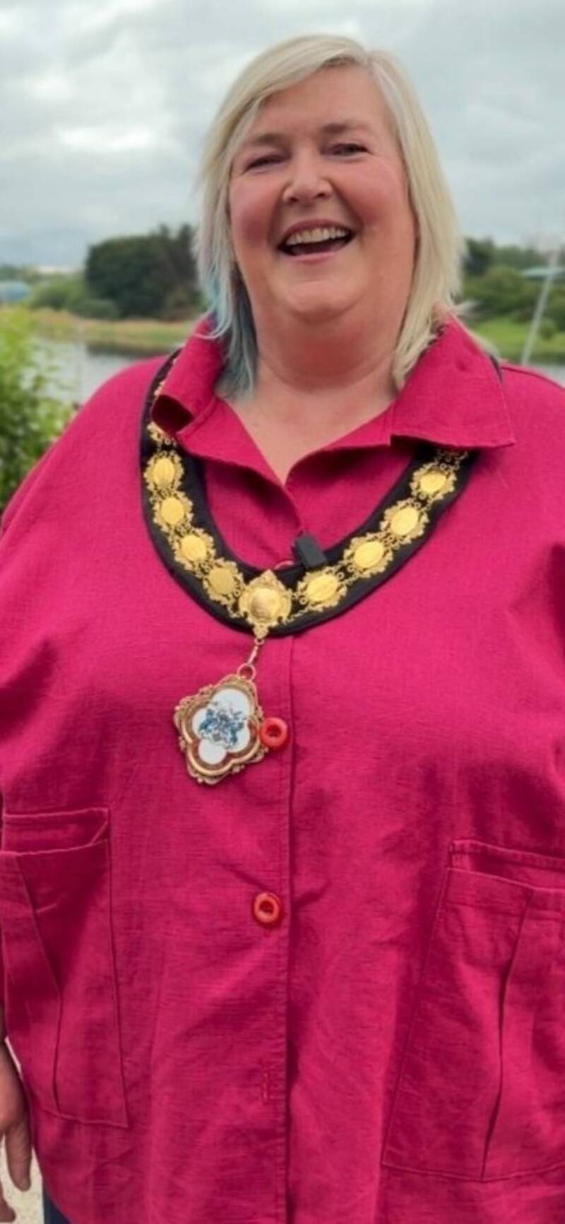
Deputy Mayor of Causeway Coast and Glens
Alderman Sandra Hunter

Slide 6
LMP Members
Department for Communities
Invest NI
Jobs and Benefits Office
NWRC
NRC
Local Enterprise Agencies
Careers Service
Northern Trust

Slide 7
LMP Action Plan
Employers
Jobs
Skills
integration

Slide 8
LMP FOCUs
Supporting employers to attract, grow and develop their people
Creating sustainable employment for unemployed and economically inactive
Upskilling existing employees
Helping those at risk of economic shock
Engaging communities and groups experiencing greatest deprivation
Shaping the future labour market
Joining up local provision
Referrals to regional programmes and support

Slide 9
Programmes
Retrain Plus Employment Academies
Start Up Seed Fund
Job Fairs and Careers Events
Skills and Lifelong Learning
Causeway Apprenticeships
Personal Learning Account

Slide 10
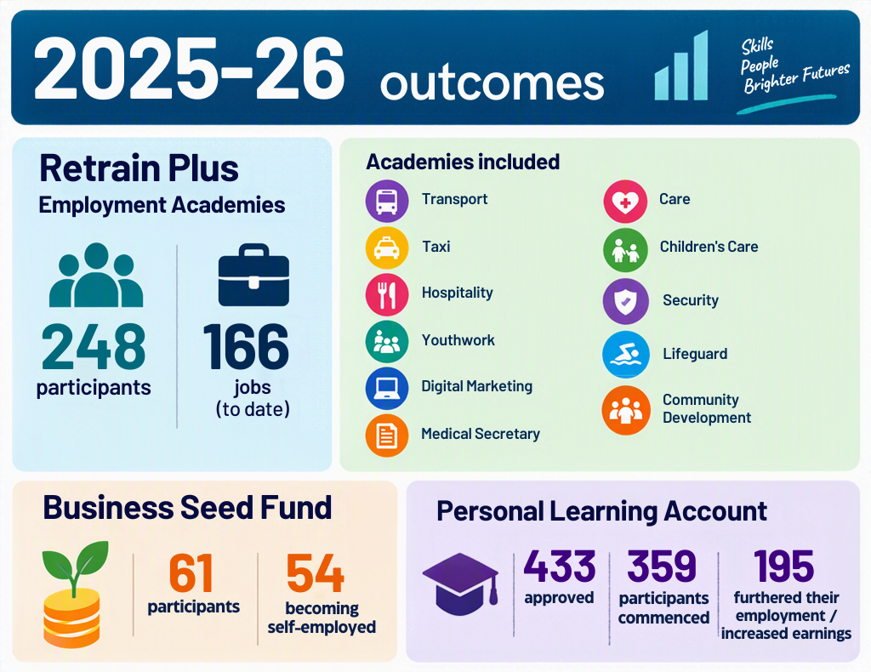

CCG LMP Achievements

Slide 11
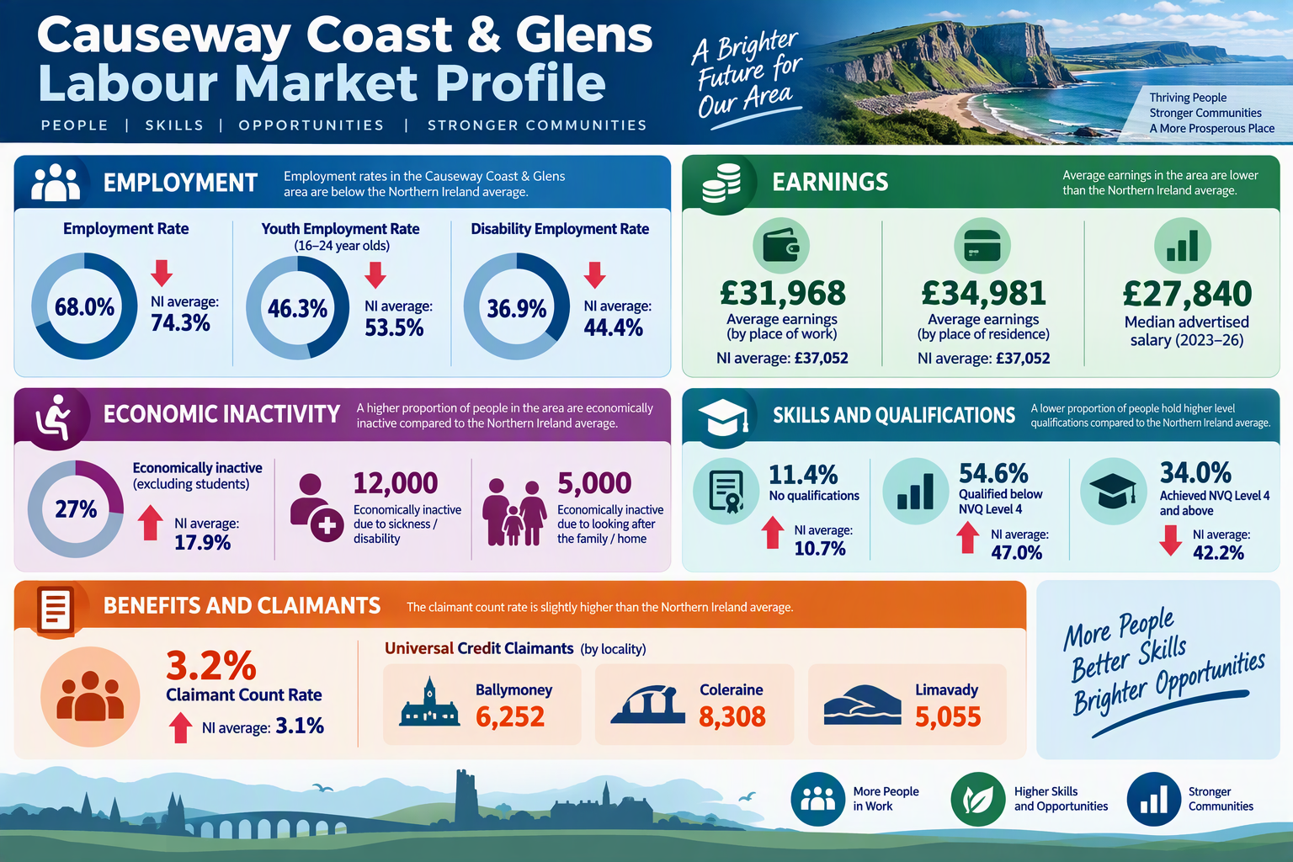

We have much more to do!

Slide 12


Employer Case Study
Kelly Croskery
Operations Manager at Platinum Support and Care

Slide 13

Employer Case Study
Declan Hassan
Director at Moore NI

Slide 14

Declan Hassan
Moore NI Chartered accountants and business advisors
Helping you thrive in a changing world

Slide 15

‘Building Stronger Leaders, Building Stronger Businesses’
Notes:
Thanks Marc and the team for the opportunity to speak today.
The theme of today is Building stronger leaders, building stronger businesses – with that in mind I’m going to talk about Distributed leadership and Job Crafting.

Slide 16
A VUCA environment.
Business is more complex than ever.
How do you keep your best people?
Can Distributed Leadership and Job Crafting Help?
Notes:
We live in a UCA environment – concept widely applied in business and leadership
Volatile – Uncertain – Complex – Ambiguous
Keep it simple – It’s complex – we live in a complicated world.
We face many challenges, and retention of our best talent is certainly one. How can we keep them?

Slide 17
Distributed Leadership
Top-Down Leadership
Slower Innovation
Lower Employee Engagement
Bottlenecks in Decision-Making
Notes:
Before I talk about distributed leadership – I need to talk about top down leadership model – This is heavily reliant on a small number of people – no longer cuts it in modern business with all it’s complexity –
Decisions are concentrated at the top, - The busiest people in the business! They have no time.
Staff may feel their opinions are not valued, leading to reduced motivation and commitment to organisational goals.
which can discourage employees from sharing ideas and limit creativity across the organisation.
3.When key decisions must be approved by senior leaders, progress can slow and organisations may become less responsive to change.

Slide 18

Distributed leadership
Combining the knowledge, abilities and skills of many individuals.
Notes:
What is distributed leadership.
Simple explanation – if everyone in here worked in an organisation, would it be better if a small number led or everyone played a part in leading?
Surely better if we combine all our knowledge, abilities and skills. What would some of the benefits be?

Slide 19
Distributed Leadership
Greater Staff Empowerment
Better Use of Expertise
Improved Agility and Resilience
Notes:
Employees are trusted to make decisions and take ownership, increasing engagement, accountability, and job satisfaction.
Knowledge and leadership are drawn from across the organisation, allowing decisions to benefit from the people closest to the issue or opportunity.
Leadership capability is spread across multiple people rather than relying on a few individuals, making the organisation more adaptable and less vulnerable to leadership absences or changes.
That’s the theory….How can you practically make it happen?
This is how we started…

Slide 20
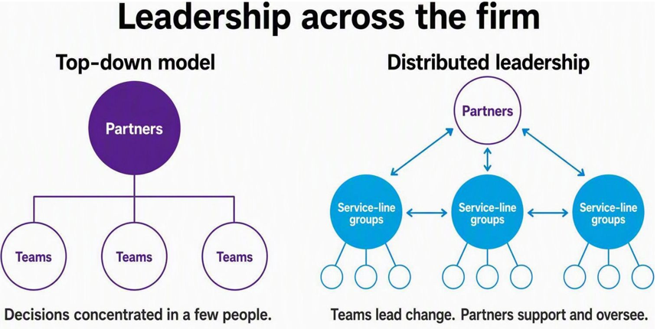
Leadership across the firm
Notes:
Every organisation is different and they all need their own model/framwork to make it happen. This is what we did.
On the left is the previous model, with decisions and change concentrated in the partners. On the right is our distributed leadership approach. People in service-line project groups have authority to improve their work, involve colleagues and report back to partners. Partners remain involved through support and oversight. We seen engagement from people who had been looking for this opportunity to have an impact,
Rapid improvements and innovation
High Employee engagement
Better use of employee’s skills.
A really important change -

Slide 21
How to make it work
Clarity and purpose
Involve the team early and set clear goals and objectives.
Space to make it happen
Promote innovation and improvements. Give people room to act.
Don’t be the barrier.
Skills and feedback
Give people the skills they need through leadership training
and feedback.
Notes:
Involve the team – important for change
Space – big change for us – chargeable time was everything
Training – another important change – We have CPD, but it always felt like a tickbox exercise rather that something really impactful. Slide at the end of some of the things we do.

Slide 22
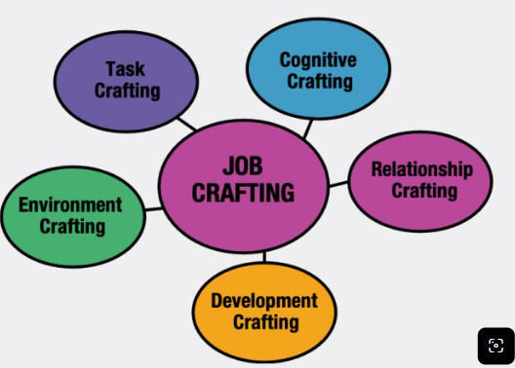
Job crafting
Notes:
Distributed leadership is about the business as a collective
Job crafting is a very specific conversation with an individual.

Slide 23
‘Work engagement’ is important for employee wellbeing and performance
“Work engagement is a positive, fulfilling, affective-motivational state of work-related wellbeing… Engaged employees have high levels of energy and are enthusiastically involved in their work.”
You can measure this using the UWES-9 work engagement scale
Notes:
Setting the scene – We talked about Retention as one of our biggest challenges - more work engagement = better retention
Job crafting helps work engagement. –Engaged staff have low levels of burn out.
Two types of burn out – too busy, not really engaged and not busy enough and not engaged.

Slide 24
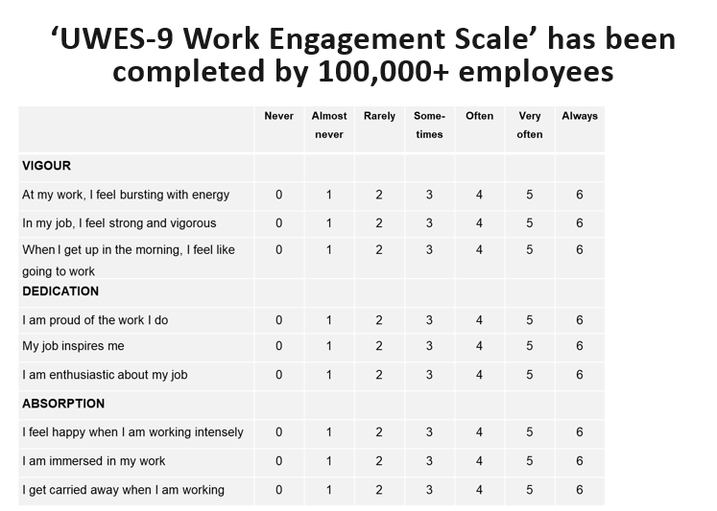
Work engagement
Notes:
This can be measured – UWES-9
Measure work engagement

Slide 25
Job crafting
“Job crafting can be seen as a specific form of proactive behaviour in which the employee initiates changes in order to make their own job more meaningful, engaging, and satisfying.”
“Turn the job you have into the job you want.”
Notes:
Job crafting boosts work engagement – read quotes.
That’s a powerful notion for someone who isn’t engaged, leave or change?

Slide 26
Job crafting
What do you enjoy?
What interests you?
What are you good at?
THE CONVERSATION
THE BENEFITS WE AIM FOR
Discuss what could change and
agree how to get there.
Greater fulfilment, better use of strengths
and more ownership of development.
Notes:
It is a very individual conversation.
We have encouraged job crafting. In the way we are using the idea, it means having a conversation about how someone can do more of the work they enjoy, what interests them and what they are good at. It is a discussion followed by an agreement about how to get there, taking account of the work, the firm and our clients need. It is not a promise that every task can change immediately. The benefits we are aiming for are greater fulfilment, better use of strengths and more ownership of development.

Slide 27
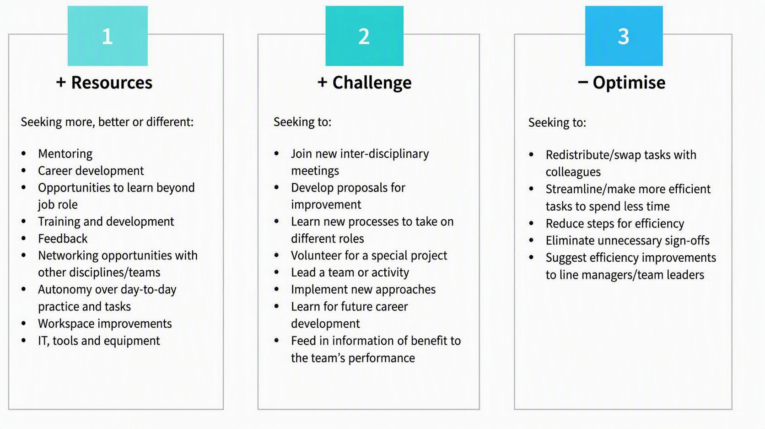
Job crafting in practice
Notes:
Look for different roles, opportunities, doing something different, learn a new process, take on new challenges
Look for resources – mentoring, learn beyond your role, feedback
Challenge – Join new initiatives, develop proposals for improvement, learn new processes, volunteer for special projects
Optimise – swap tasks, look for efficiency

Slide 28





Job crafting – Moore NI examples
Heather - Charity
Suzanne – SDLT service
Mairead – Corporate Finance
Matthew - Outsourcing
Megan and Jasmine – LinkedIn
Lauren - Social
Laura – AI and Data Analyst
Notes:
Examples
Three service line based examples
Job crafting has a wide scope and a variety of opportunities
Lauren – A trainee accountant – joined the Social committee – she lights up – best person for the job.
Heather – An experienced accountant – she is our Charity rep – that’s what she is now known for now, she cares about it, set up CSR volunteering days for everyone.
Laura – A very busy accounts manager – Job crafted – Interested in data analytics – doing a course in Data analytics and AI – very beneficial for her – and for the firm – we have not had the time to do an exercise that she is doing for us now, and I don’t know where she got the time, but I have never seen her more energised – more engaged, and enthusiastic –
These have all job crafted in their own way and we have seen the benefits of work engagement, job satisfaction and retention.
That’s my talk on distributed leadership and job crafting.
I just want to finish with two quick slides

Slide 29
Skills, Training, Feedback
Leadership courses –
Moore Catalyst/ Coaching house.
University of Ulster Mini MBA funded courses.
Mentorship programmes.
Leadership charter.
Appraisal/ Feedback culture.
Notes:
These are areas we are invested in.
Highlighted UU courses are something you can all look into.
Fully funded.
Happy to email you a copy of our leadership charter, get in touch.

Slide 30


Audio Books
Notes:
Two books I recommend
Turn the ship around is a true story, and an excellent example of distributed leadership in action.
Radical Candor is a book we have been telling our people about to help build a positive culture around feedback.

Slide 31
To conclude
Business is complex
Use all your people to help lead
Distributed leadership
Retention is challenging
Keep your people engaged
Encourage Job Crafting
Give people the skills, training and feedback they need
Notes:
Setting the scene – We talked about Retention as one of our biggest challenges - more work engagement, job satisfaction, fulfilment = better retention
Job crafting helps work engagement.

Slide 32
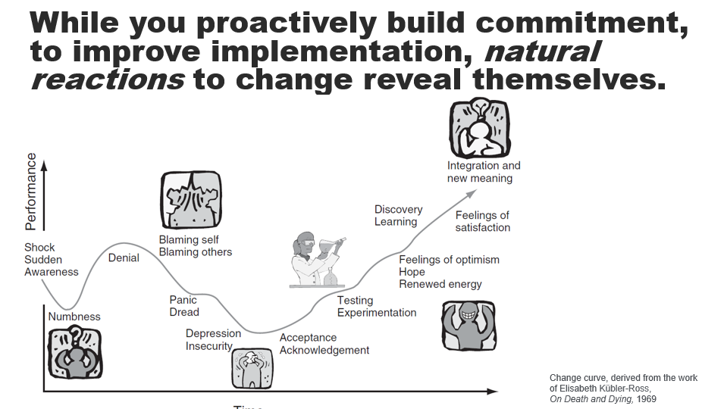
Implementing change
Notes:
Understanding change curve

Slide 33

Skills SUPPORT
Catherine McGuigan
Head of Leadership & Capability Development at Invest NI
Skills & Competitiveness Division

Slide 34

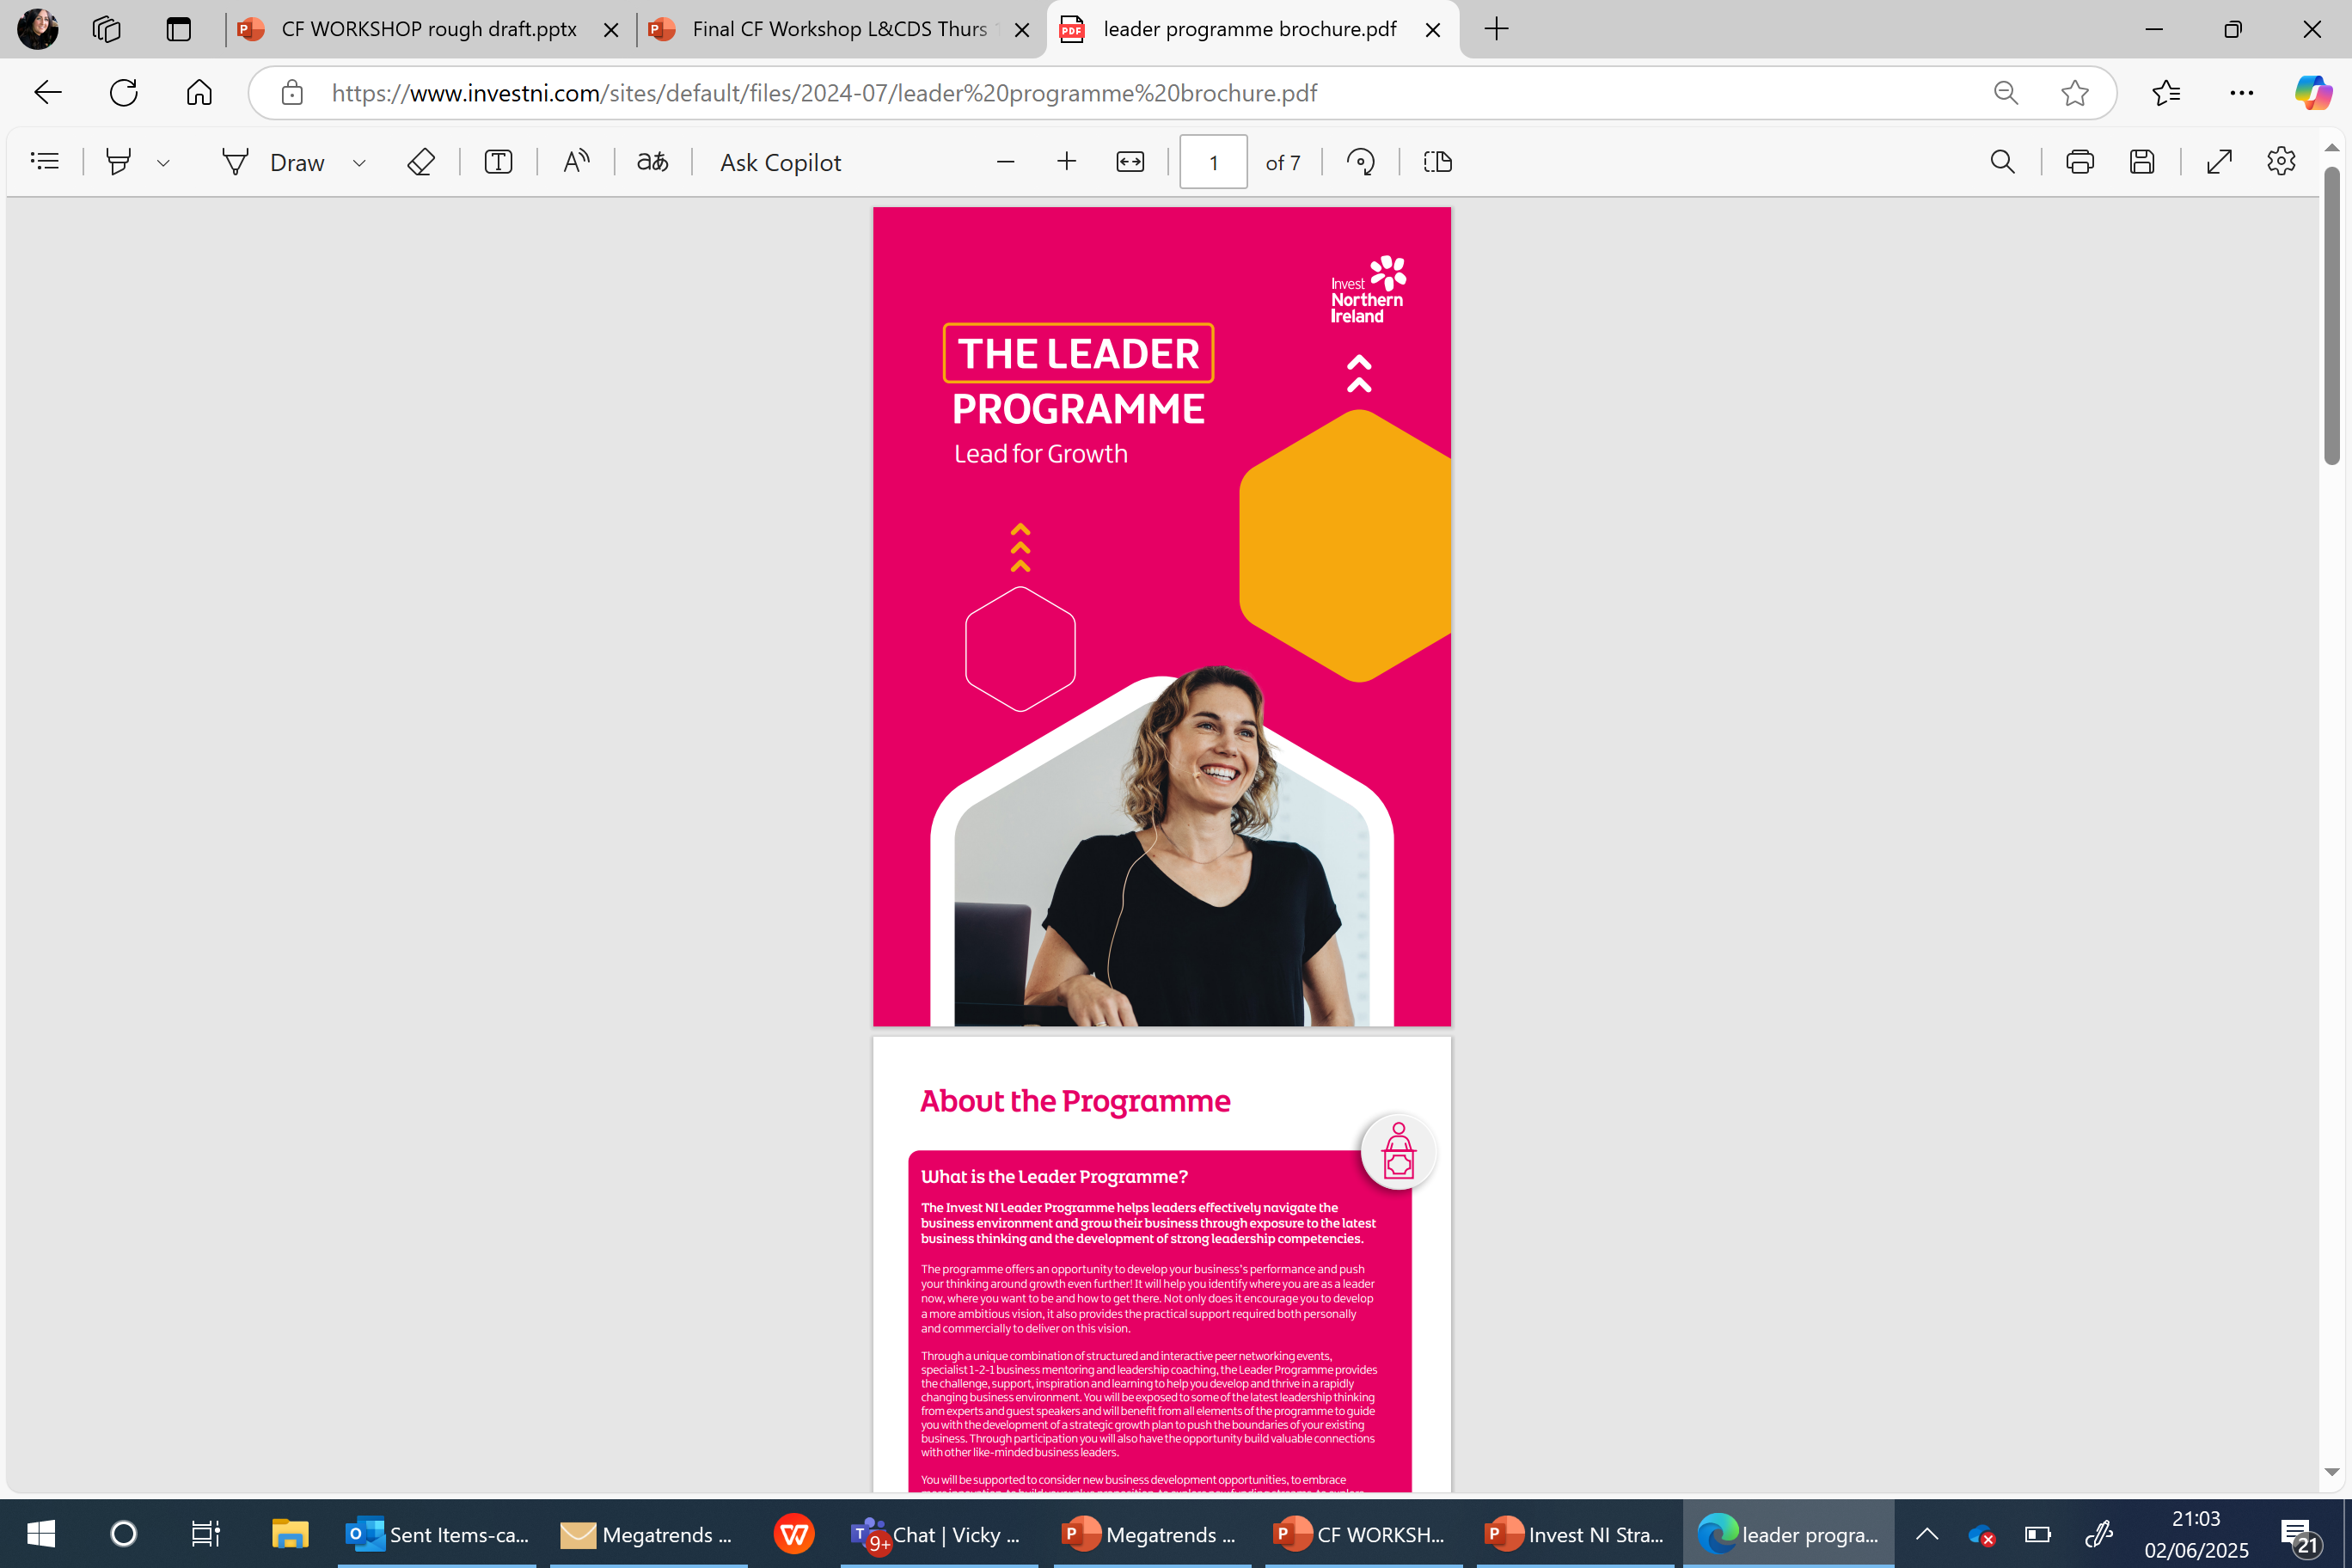
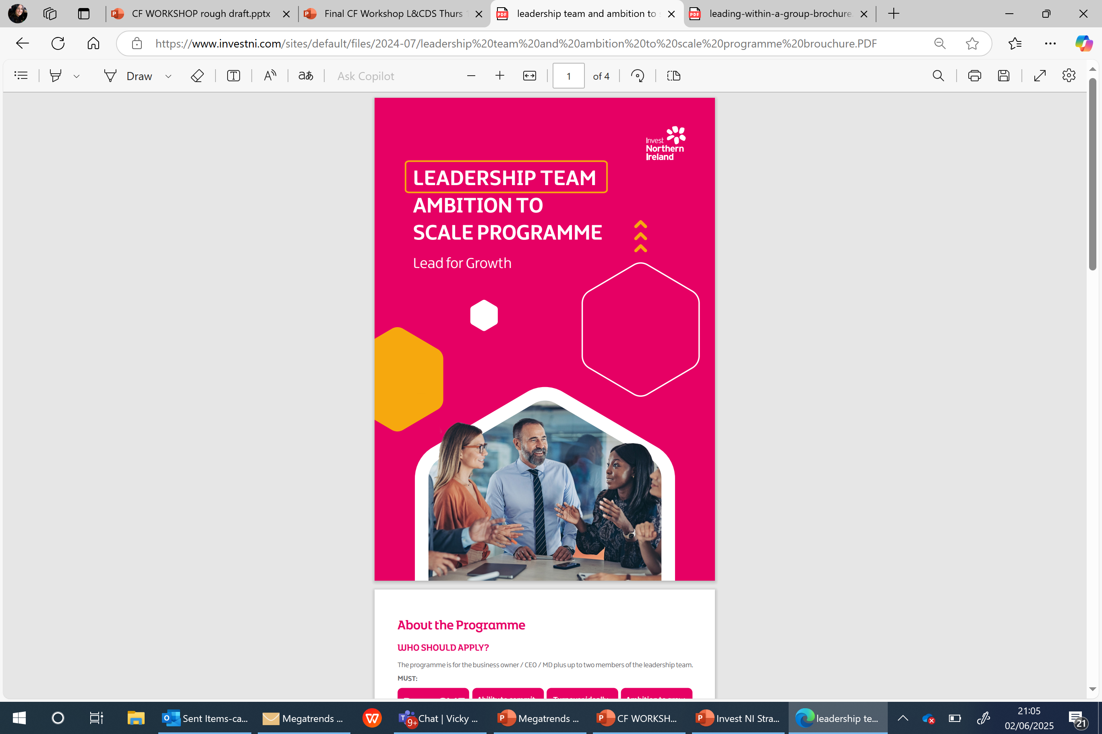
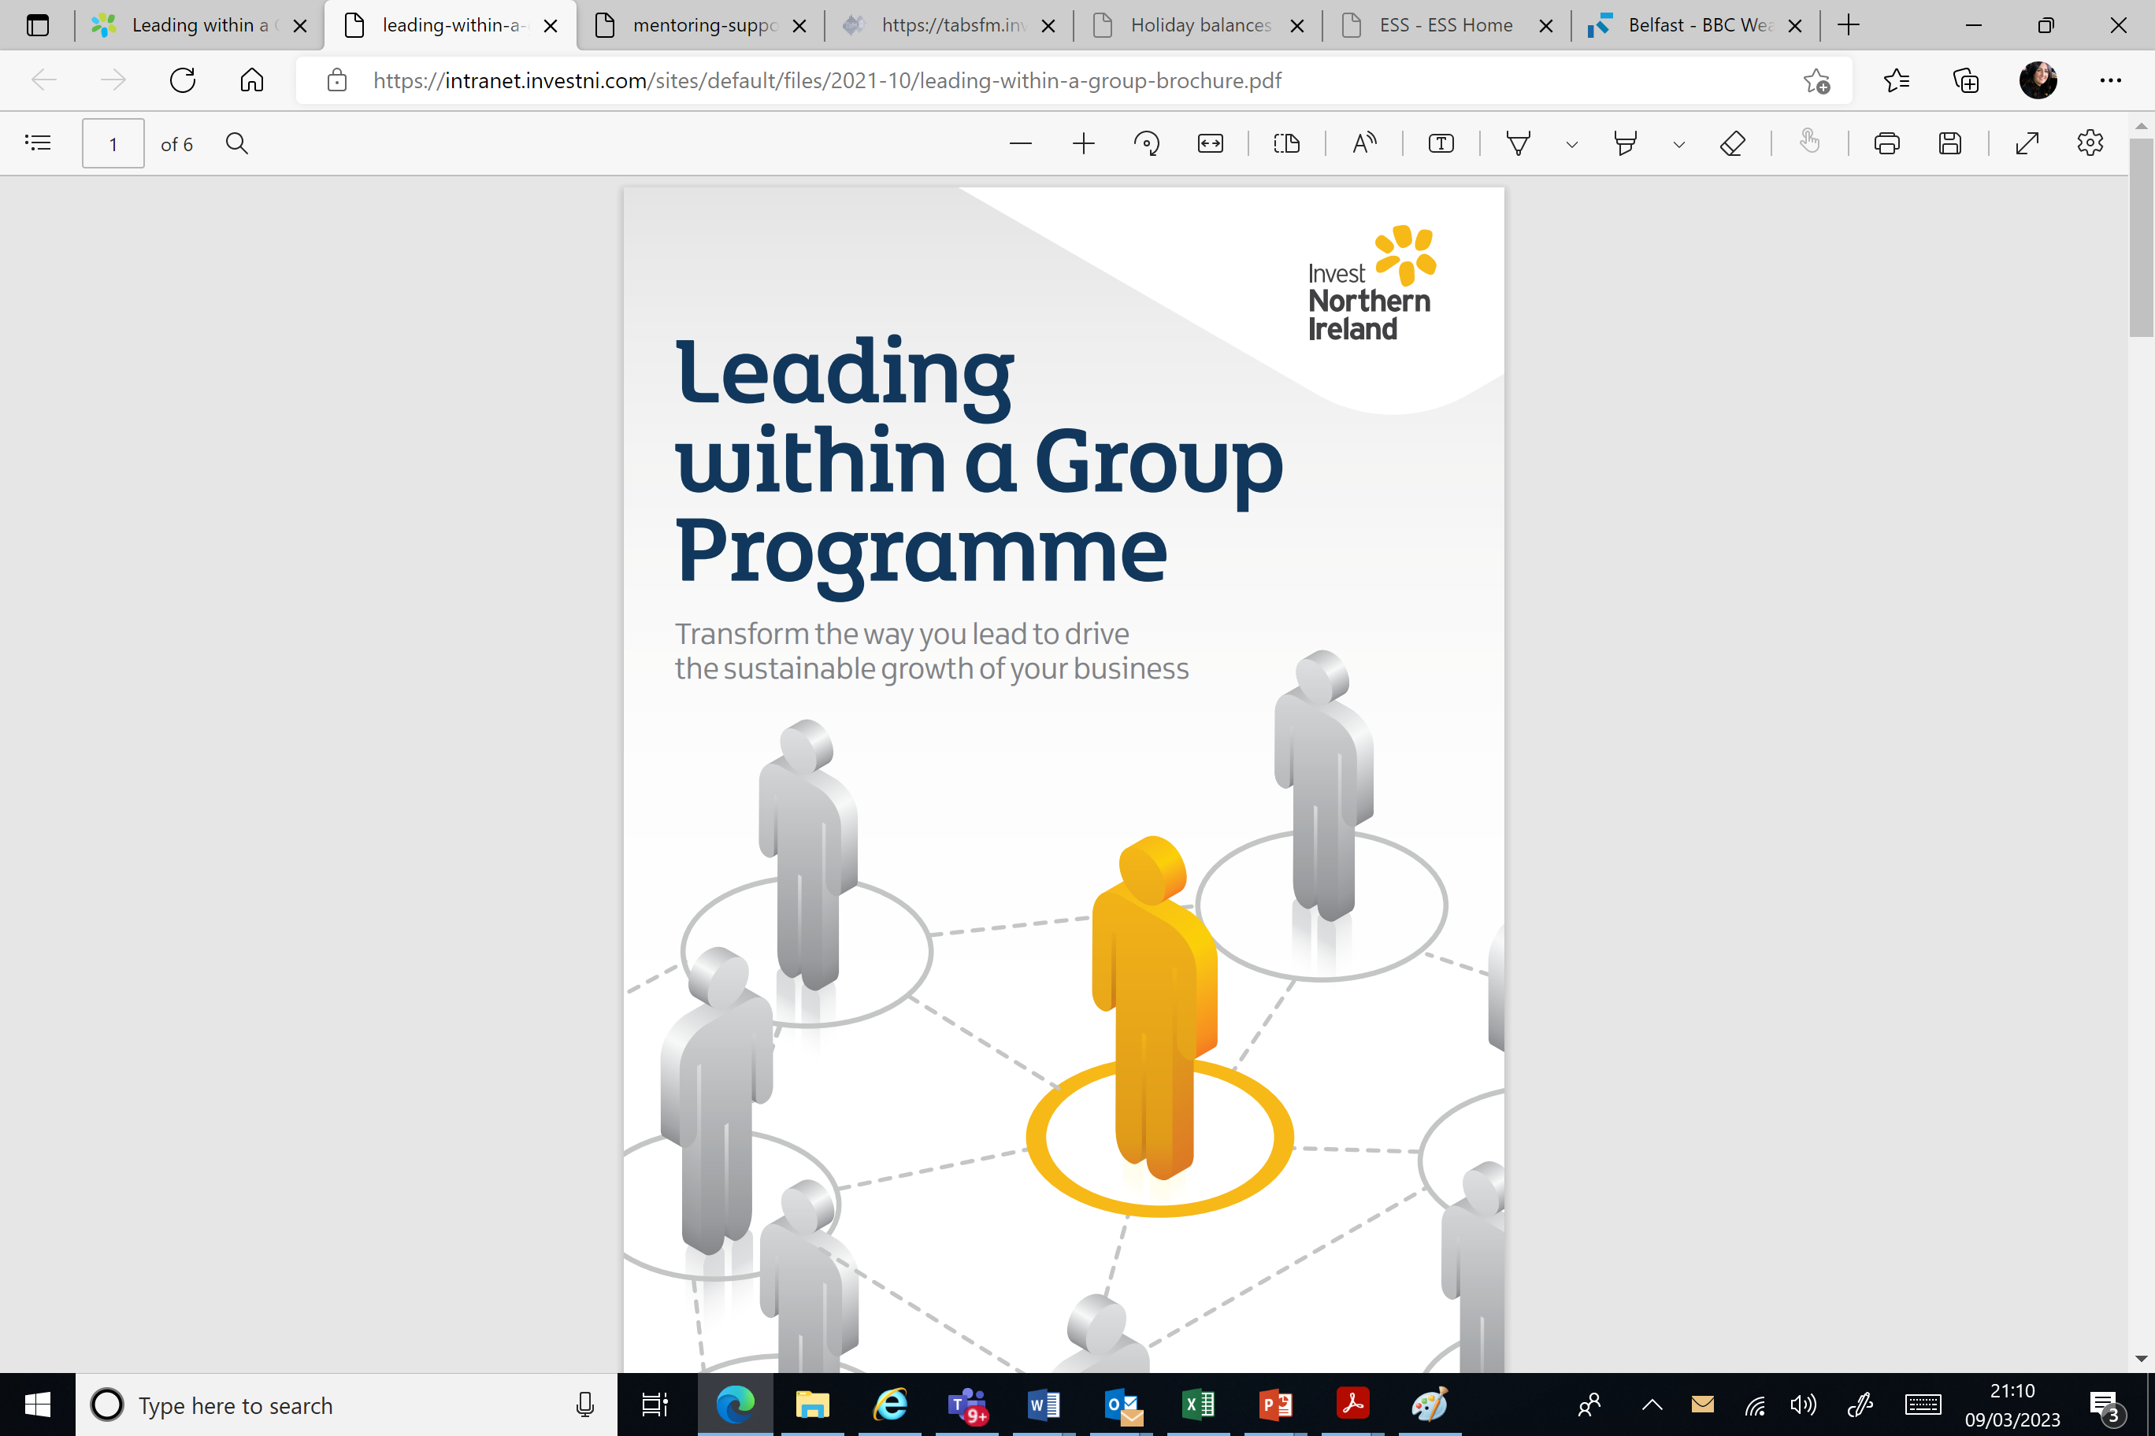

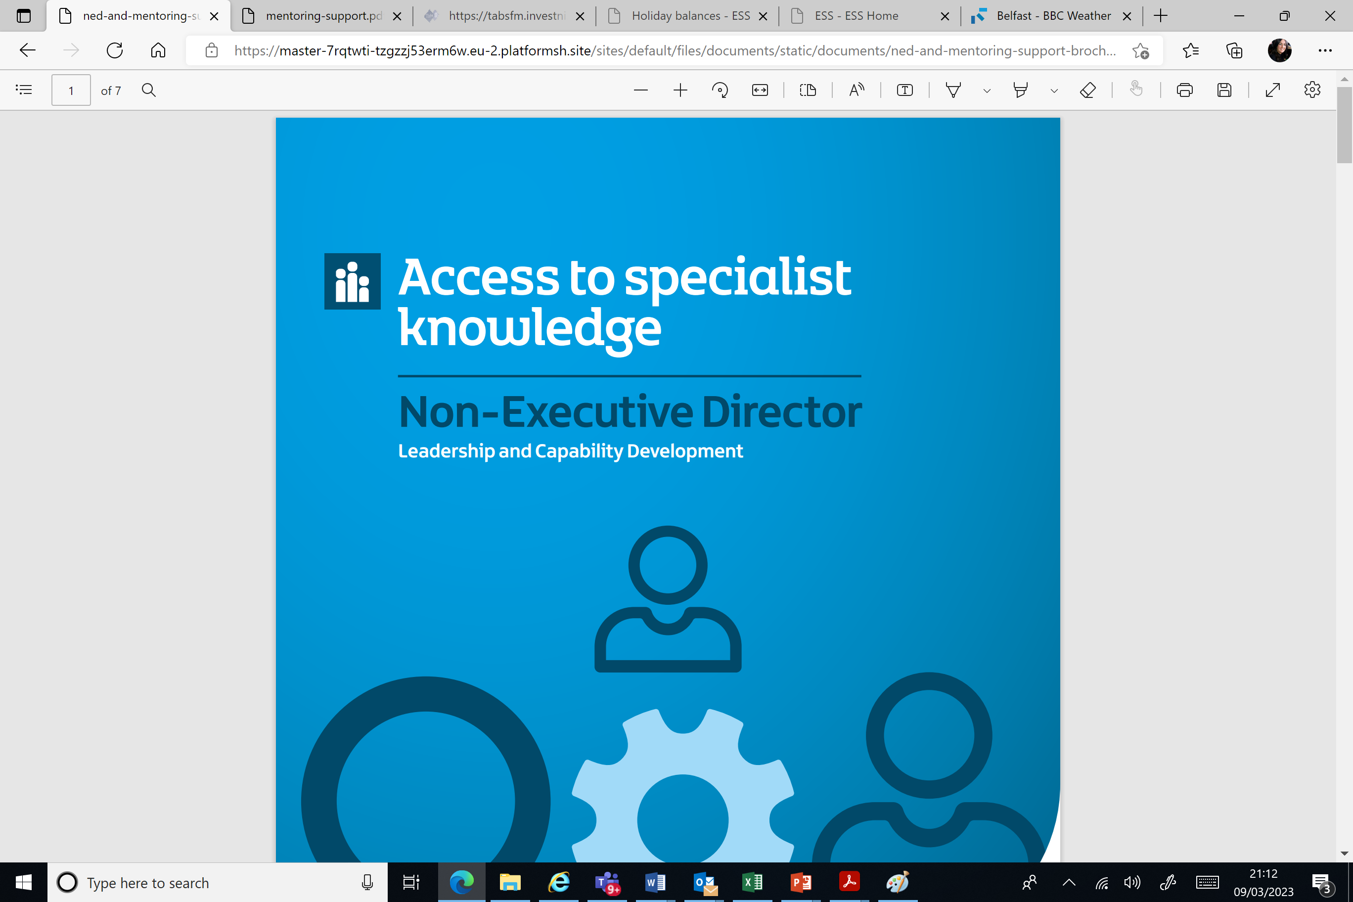
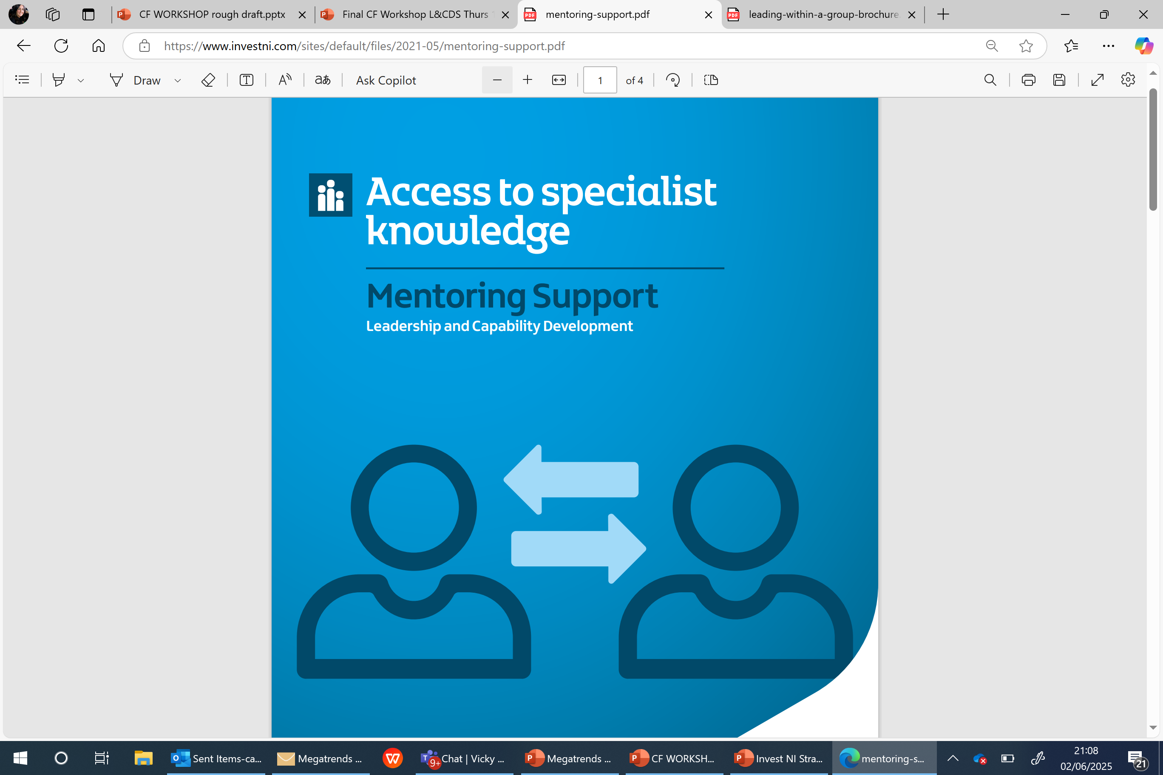





Strategic Leadership & Capability Development Solutions
Driving global ambition, developing strategic leadership capability and supporting productivity improvement!

Slide 35
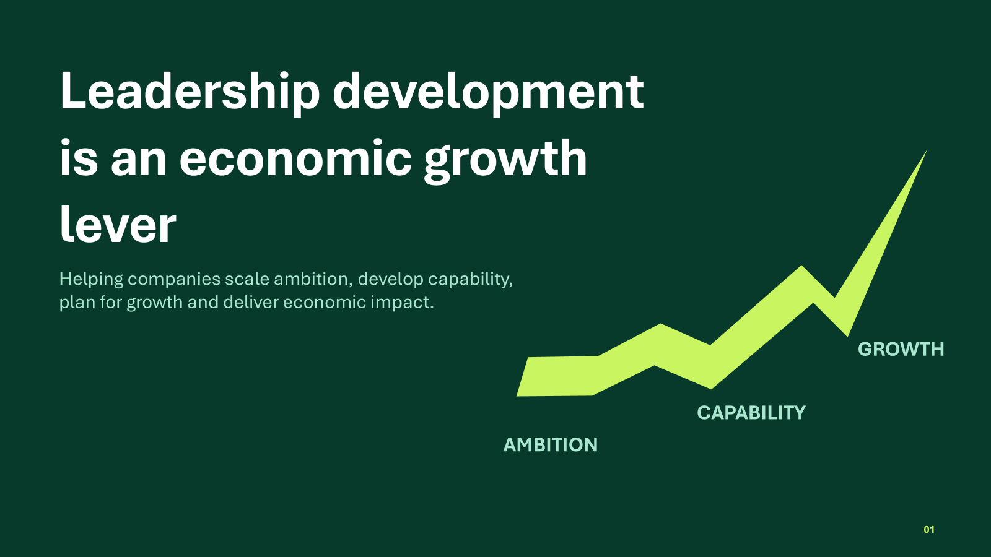

Slide 36
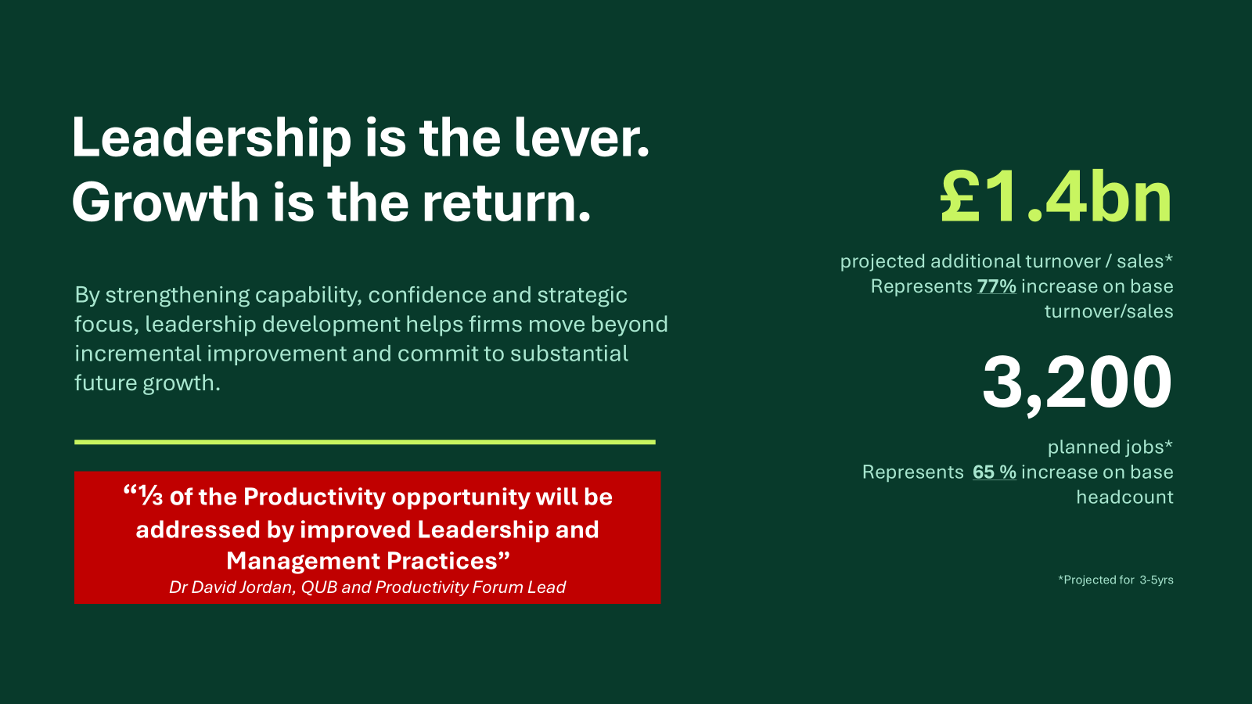

Slide 37




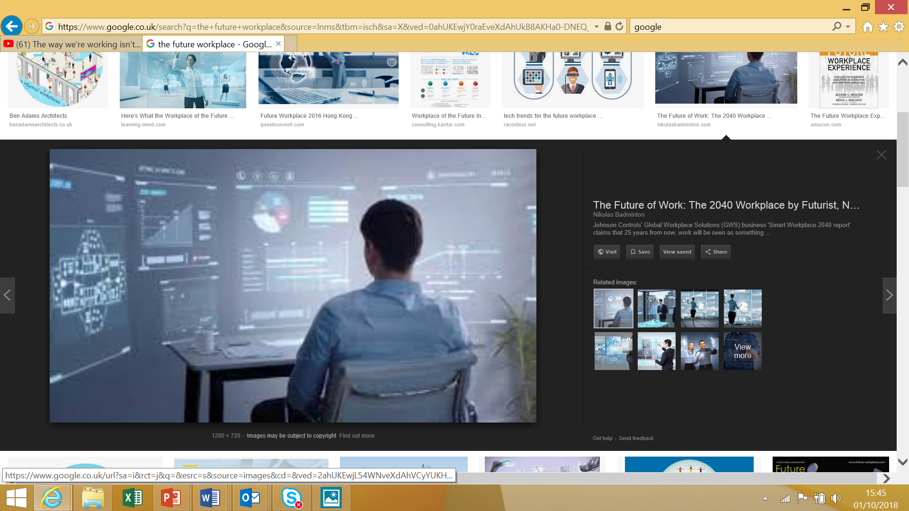



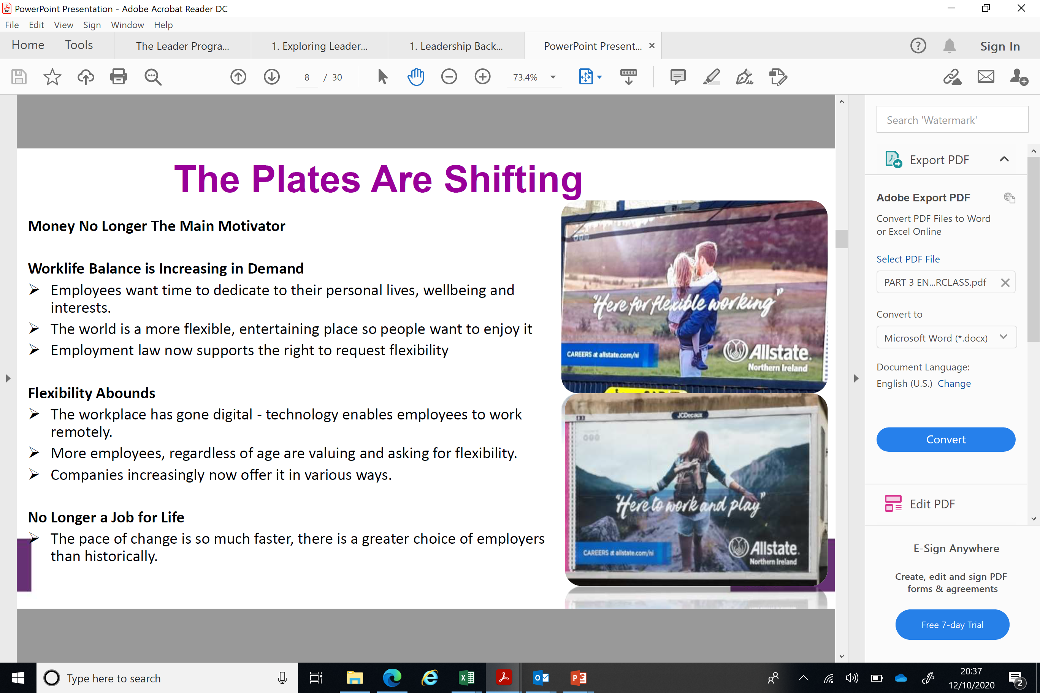
The World Of Work Is Evolving
The World of Work is Evolving
Leaders in 2026 must continue navigate increasing complexity, embrace technological change, maximise human engagement, drive agility and achieve both horizontal and vertical growth.
Notes:
Money No Longer The Main Motivator
AI and Digitisation continues to transform traditional roles, processes and create new opportunities
Competition for talent is rising – employers need strong EVP’s
Worklife Balance is Ever Increasing in Demand
Flexibility abounds – technology enables
People Are More Emotionally Aware
Generational differences – pace of change is rapid
People Need Feedback And Recognition
VUCA World - Leadership Needs to Constantly Adapt

Slide 38
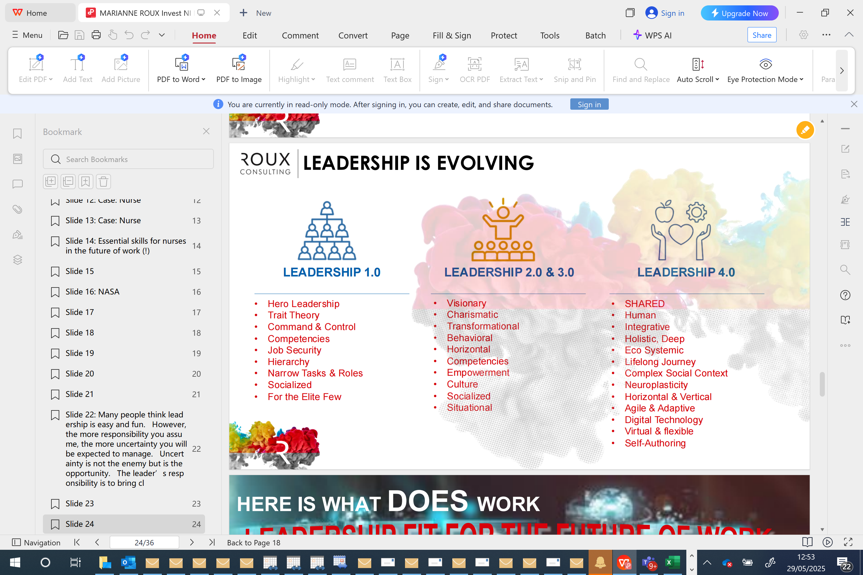
Leadership is Evolving
Industry 5.0 –
will focus on bringing human, social and environmental dimensions back into the equation of technological advances
While leaders need to build skills and knowledge regarding Data, AI Integration, Cybersecurity, Complex Problem Solving and Human/Machine Optimisation…..
They also need to maximise a blend of traditional capabilities such as excellent communication skills and decision making with adaptability, strong social emotional intelligence, collaborative focus and an ability to lead technological transformation at pace

Slide 39
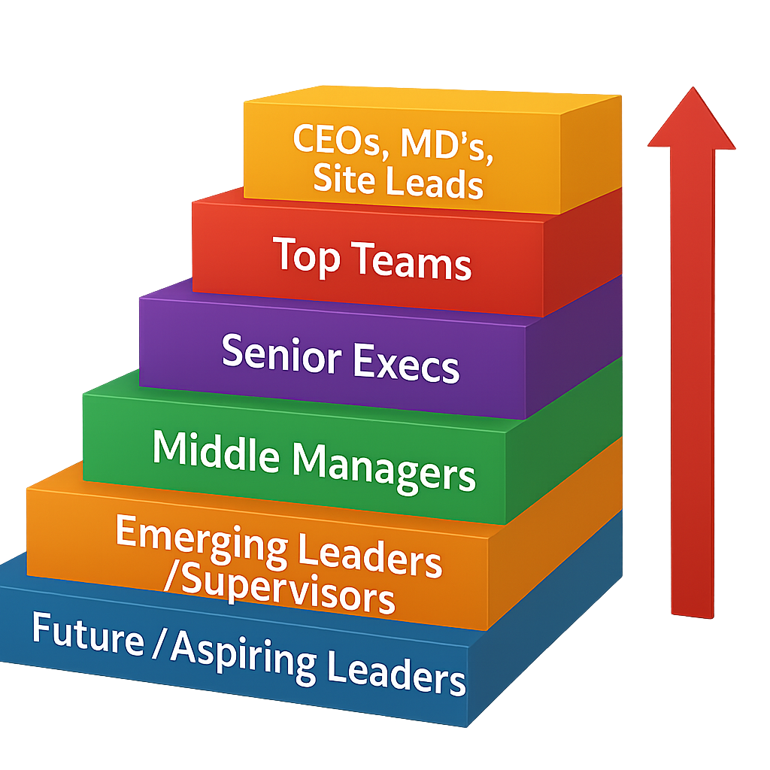

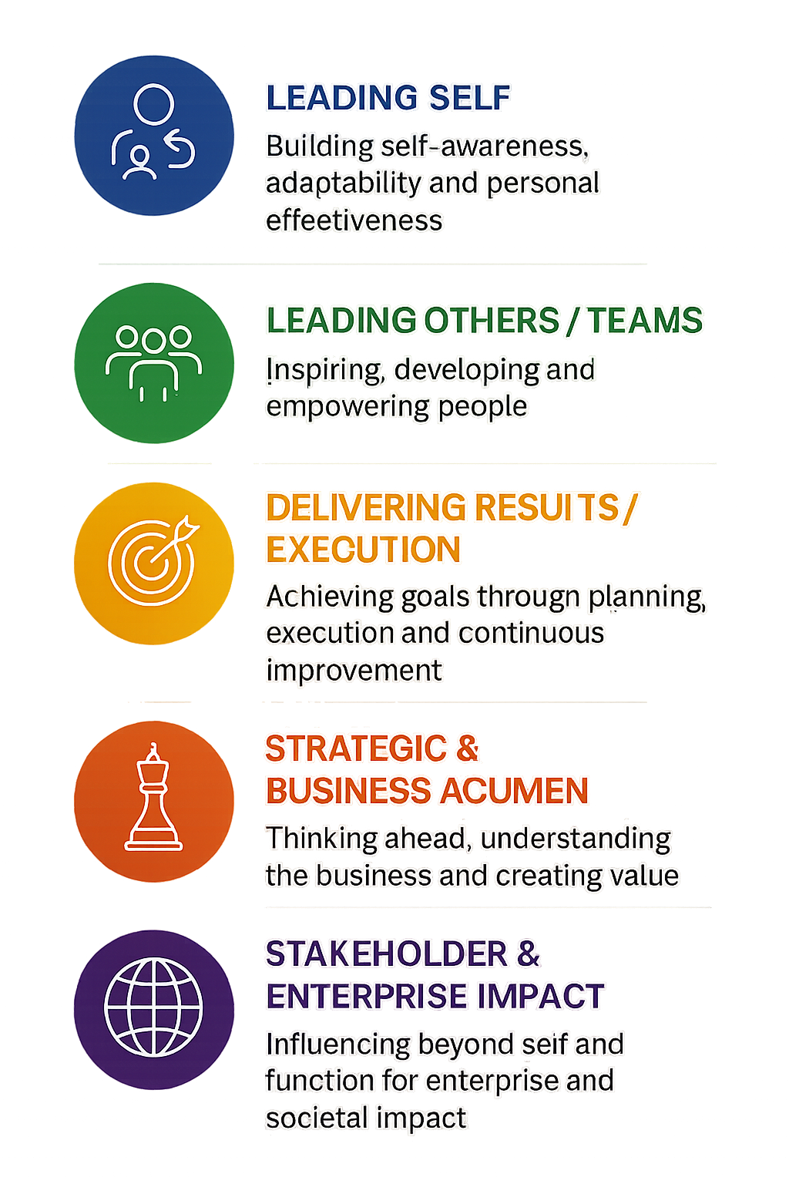

Slide 40

Leadership 2026 - What’s needed?
Rising in importance and impact
Authentic, social and emotionally conscious leadership (ESQ)
Leadership ‘Agency’ – Influence Ability
Adaptive leadership
Collective leadership
Notes:
Best Leaders Lead Through Influence, Not The Power Of Position
COLLECTIVE LEADERSHIP No Single Leader Directly Controls All Parts Of The Network, Leadership Is Distributed.
INFLUENCE Is So Important. To Earn That Influence, Leaders Have To Secure The Trust And Respect
ENGAGEMENT Requires Empathy And Exceptional Communications Skills.
Best Leaders See And Appreciate The Big Picture, Have PURPOSE
LEADERS IN 2019 MUST BE ADAPTIVE
[Sources]
AI-generated illustrative workplace discussion, 12 October 2026. Not an actual Invest NI team or event. Slide content retained from the source presentation.
[/Sources]

Slide 41
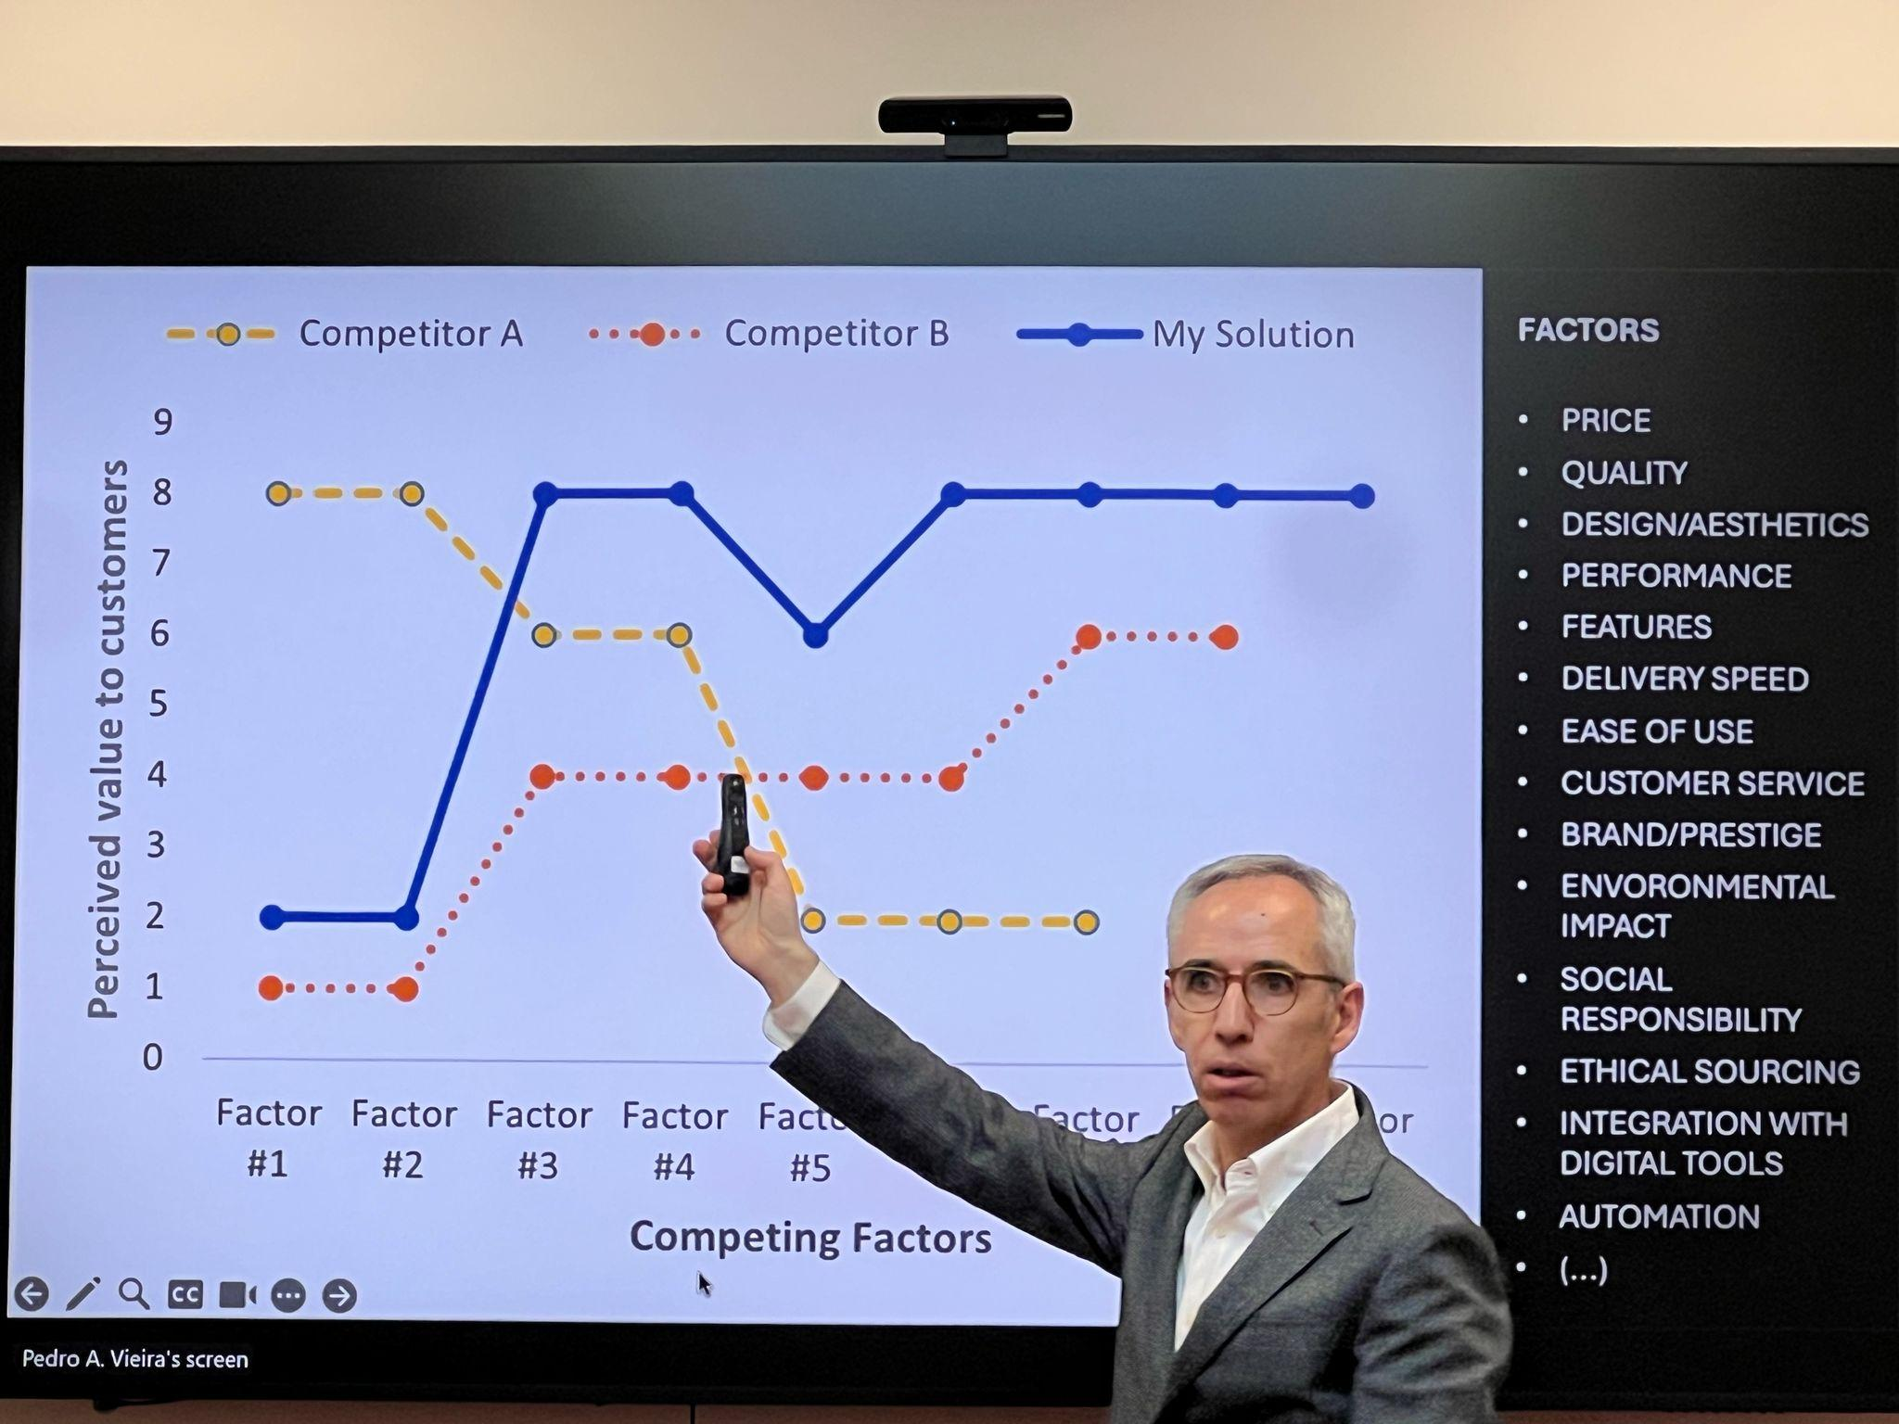
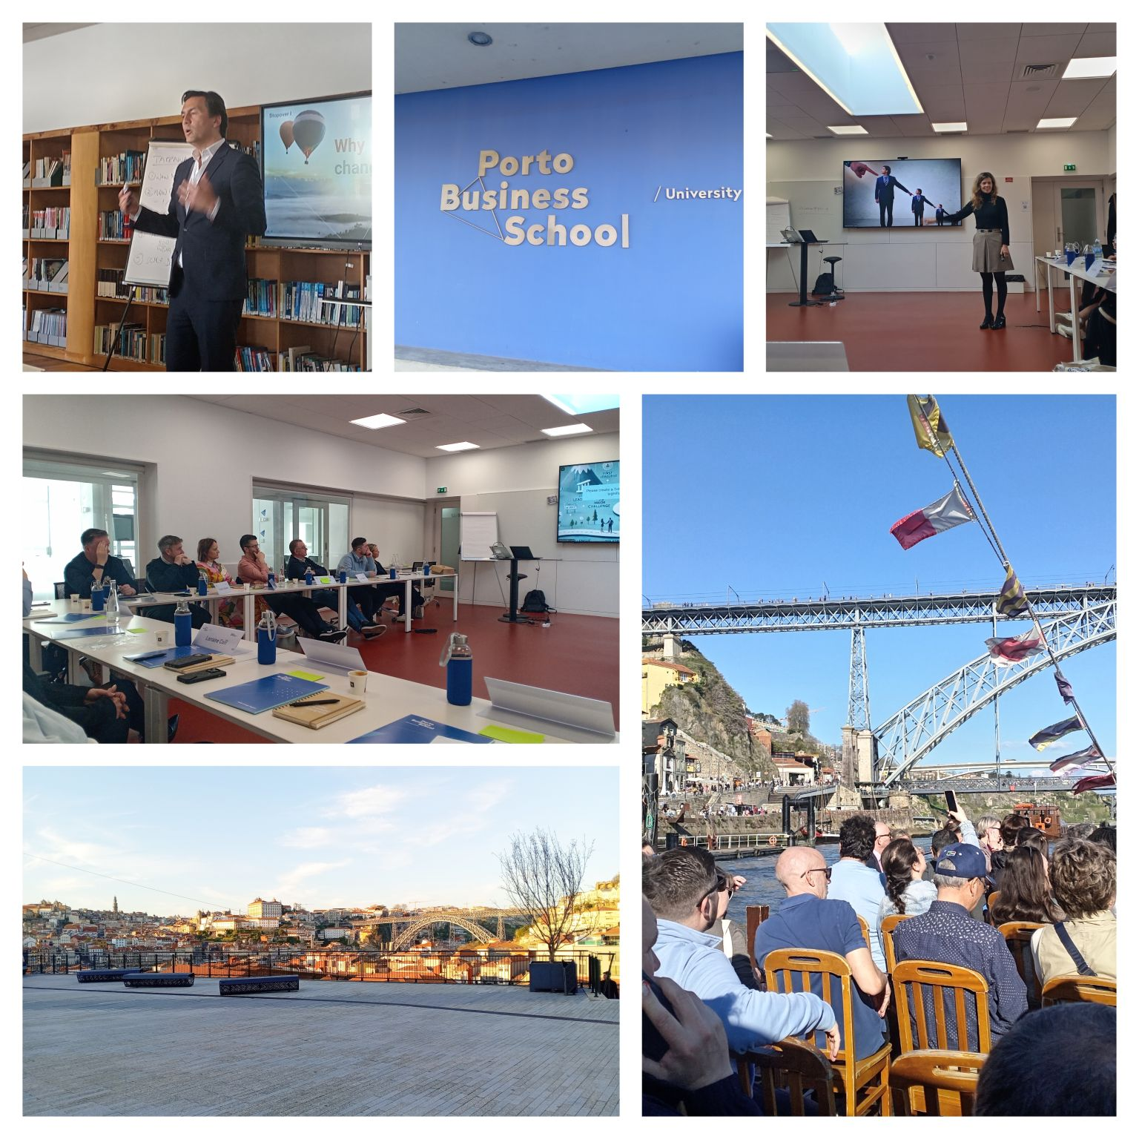
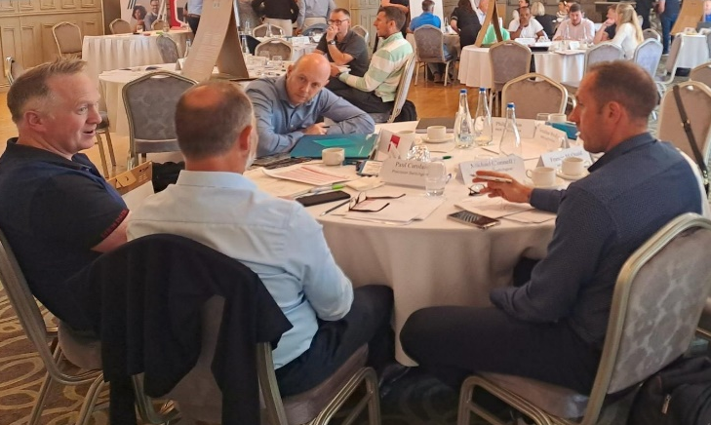
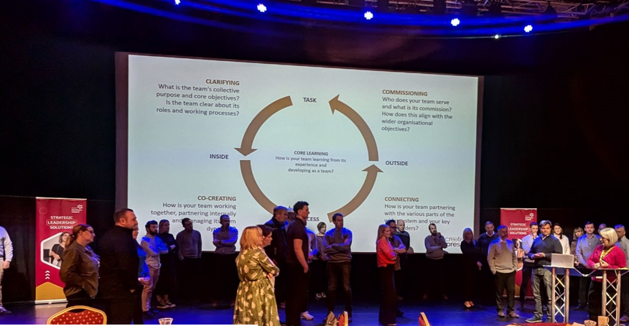
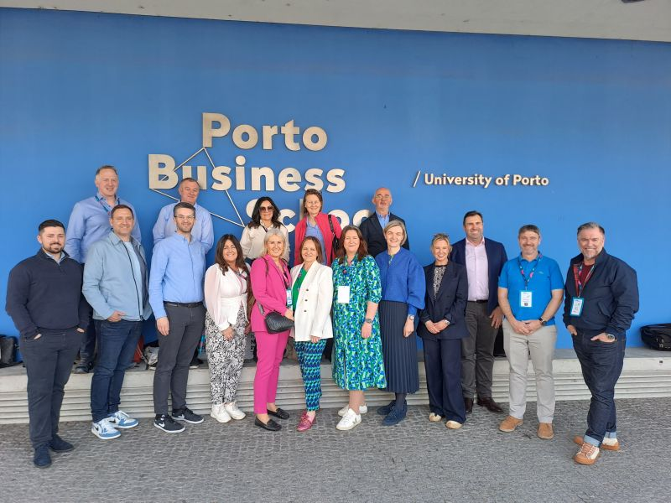
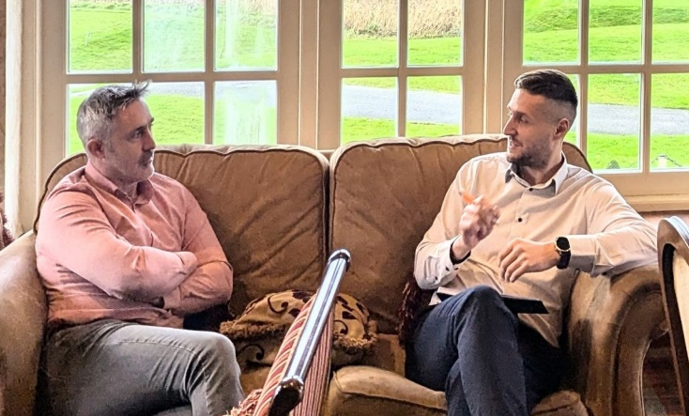
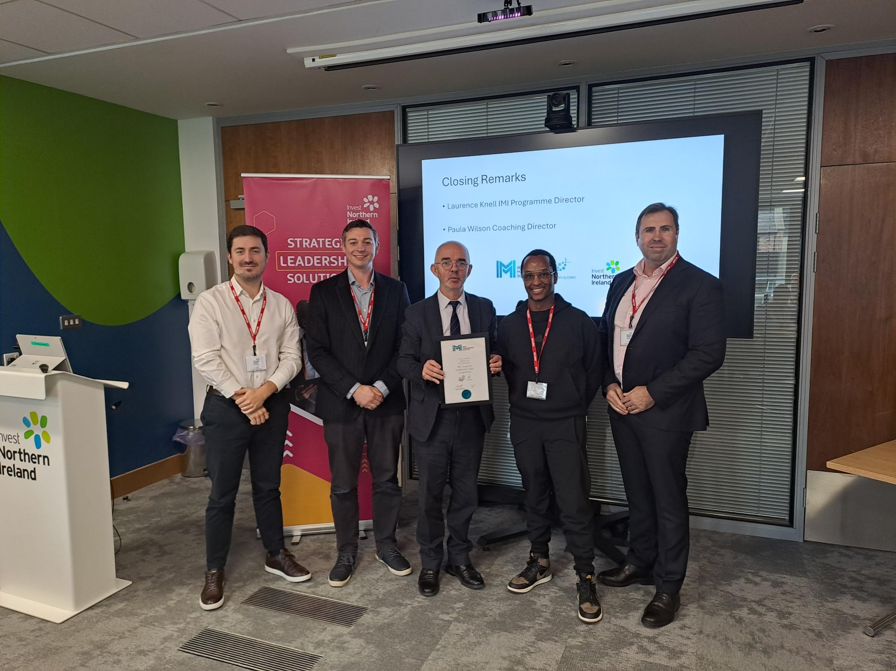
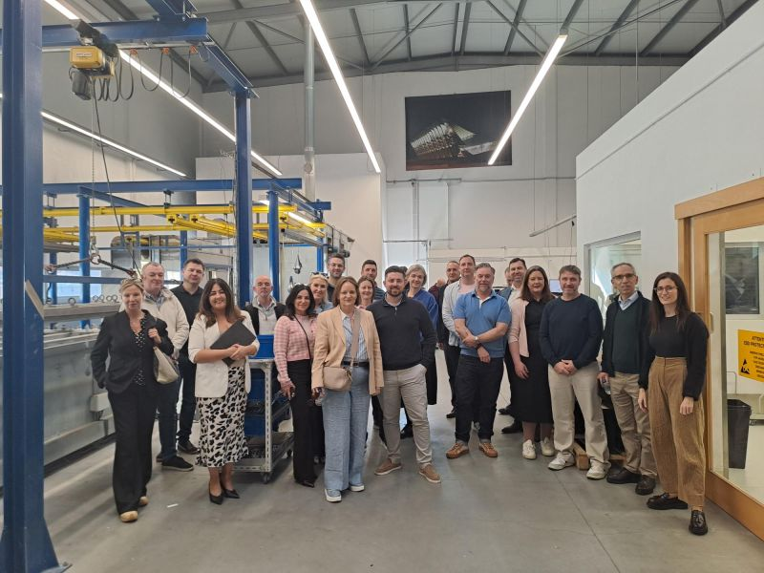
‘Uniquely Blended’ Solutions to
Help Develop Strategic Leadership Capability
and Drive Business Growth
World Class Executive Education
Expert Facilitators
& Guest Speakers
Practical
Case Studies
& Masterclasses
Leadership
Diagnostics
Peer Learning
Sessions & Site
Visits
Leadership & Top Team Coaching
International Learning Experiences
Online Learning
Portal
Self -Reflection, Time to Recharge and Focus
Strategic Growth Plan Development

Slide 42
Strategic Leadership Continuum
  Leadership Alumni Network & Best Practice Events\
  Leadership for Growth L4G
Link to webpage : Leadership and Management Advice Service | Invest Northern Ireland
Entry and Account Managed ---------------- Focus and Pre Scaling Companies ------------------Pre & Scaling Companies----
Strategic programme for sales leaders wanting to develop international sales growth plan
Guidance and financial support £10K to engage a experienced NED to assist leaders with strategic direction, governance and board development
Top teams of growth companies, 10mth blended programme, Combines World Class Executive Education Workshops, Top Team Coaching, Facilitated Peer Learning Sessions, International CEO Module with Porto Business School
Strategic Leadership Programme for site leads and senior executives of externally owned companies with a complex group structure needing to elevate competitiveness and lead company development
Strategic Leadership Development Programme for MD/CEO or Future MD - Blended 10mth Programme, Combining Peer Workshops, Specialist Mentoring, Leadership Coaching, CMI Endorsed and Growth Plan Output 100% support for leadership workshops and 49% support for coaching and mentoring
Financial support £4K and guidance towards selecting a strategic mentor to assist leaders with 12mth key business improvement projects
Leadership
Peer
Networks & Events
1-2-1 Expert L&Mgt Advice, guidance, coaching and signposting for clients and wider business base companies

Slide 43

The Leader Programme
MD/CEO or Future MD Designate
Blended 10mth Programme
Combining Peer Workshops, Specialist Mentoring, Leadership Coaching
CMI Endorsed
100% support for leadership workshops and 49% support for coaching and mentoring

Slide 44




October
20th
Invest NI
Programme Launch
09:00-13:00
Leadership Vision &
Growth
Challenge
1
November
17th &18th
**Residential**
Session 1&2
Day 1 : Leading Self,
Influence &
Impact
--------
Day 2 : Leading a Scaling Organisation for Strategic Growth
12th January
Session 3
Leading Innovation, Opportunity & Growth
3rd March
Session 4
Leadership Top Team Insights Event
Leading High-Performing Teams for Growth
14th April
Session 5
Leading Culture,
Governance
and Sustainable
Growth
May
25th & 26th
**Residential**
Session 6&7
Day 1: Digital Transformation & Leading with AI
--------
Day 2: Future of Leadership & Personal Brand
June 2027
23rd
Mid Point Review
Business Growth Presentation Finale Event
09:00-13:00
GROWTH PLAN PREP
Peer Learning Group
Peer Learning Group
1.5hrs
Peer Learning Group
1.5hrs
Peer Learning Group
Peer Learning Group
Peer Learning Group
1-2-1 Business Mentoring (Up to 5 days)
1-2-1 Leadership Coaching (Up to 3 days)

Slide 45
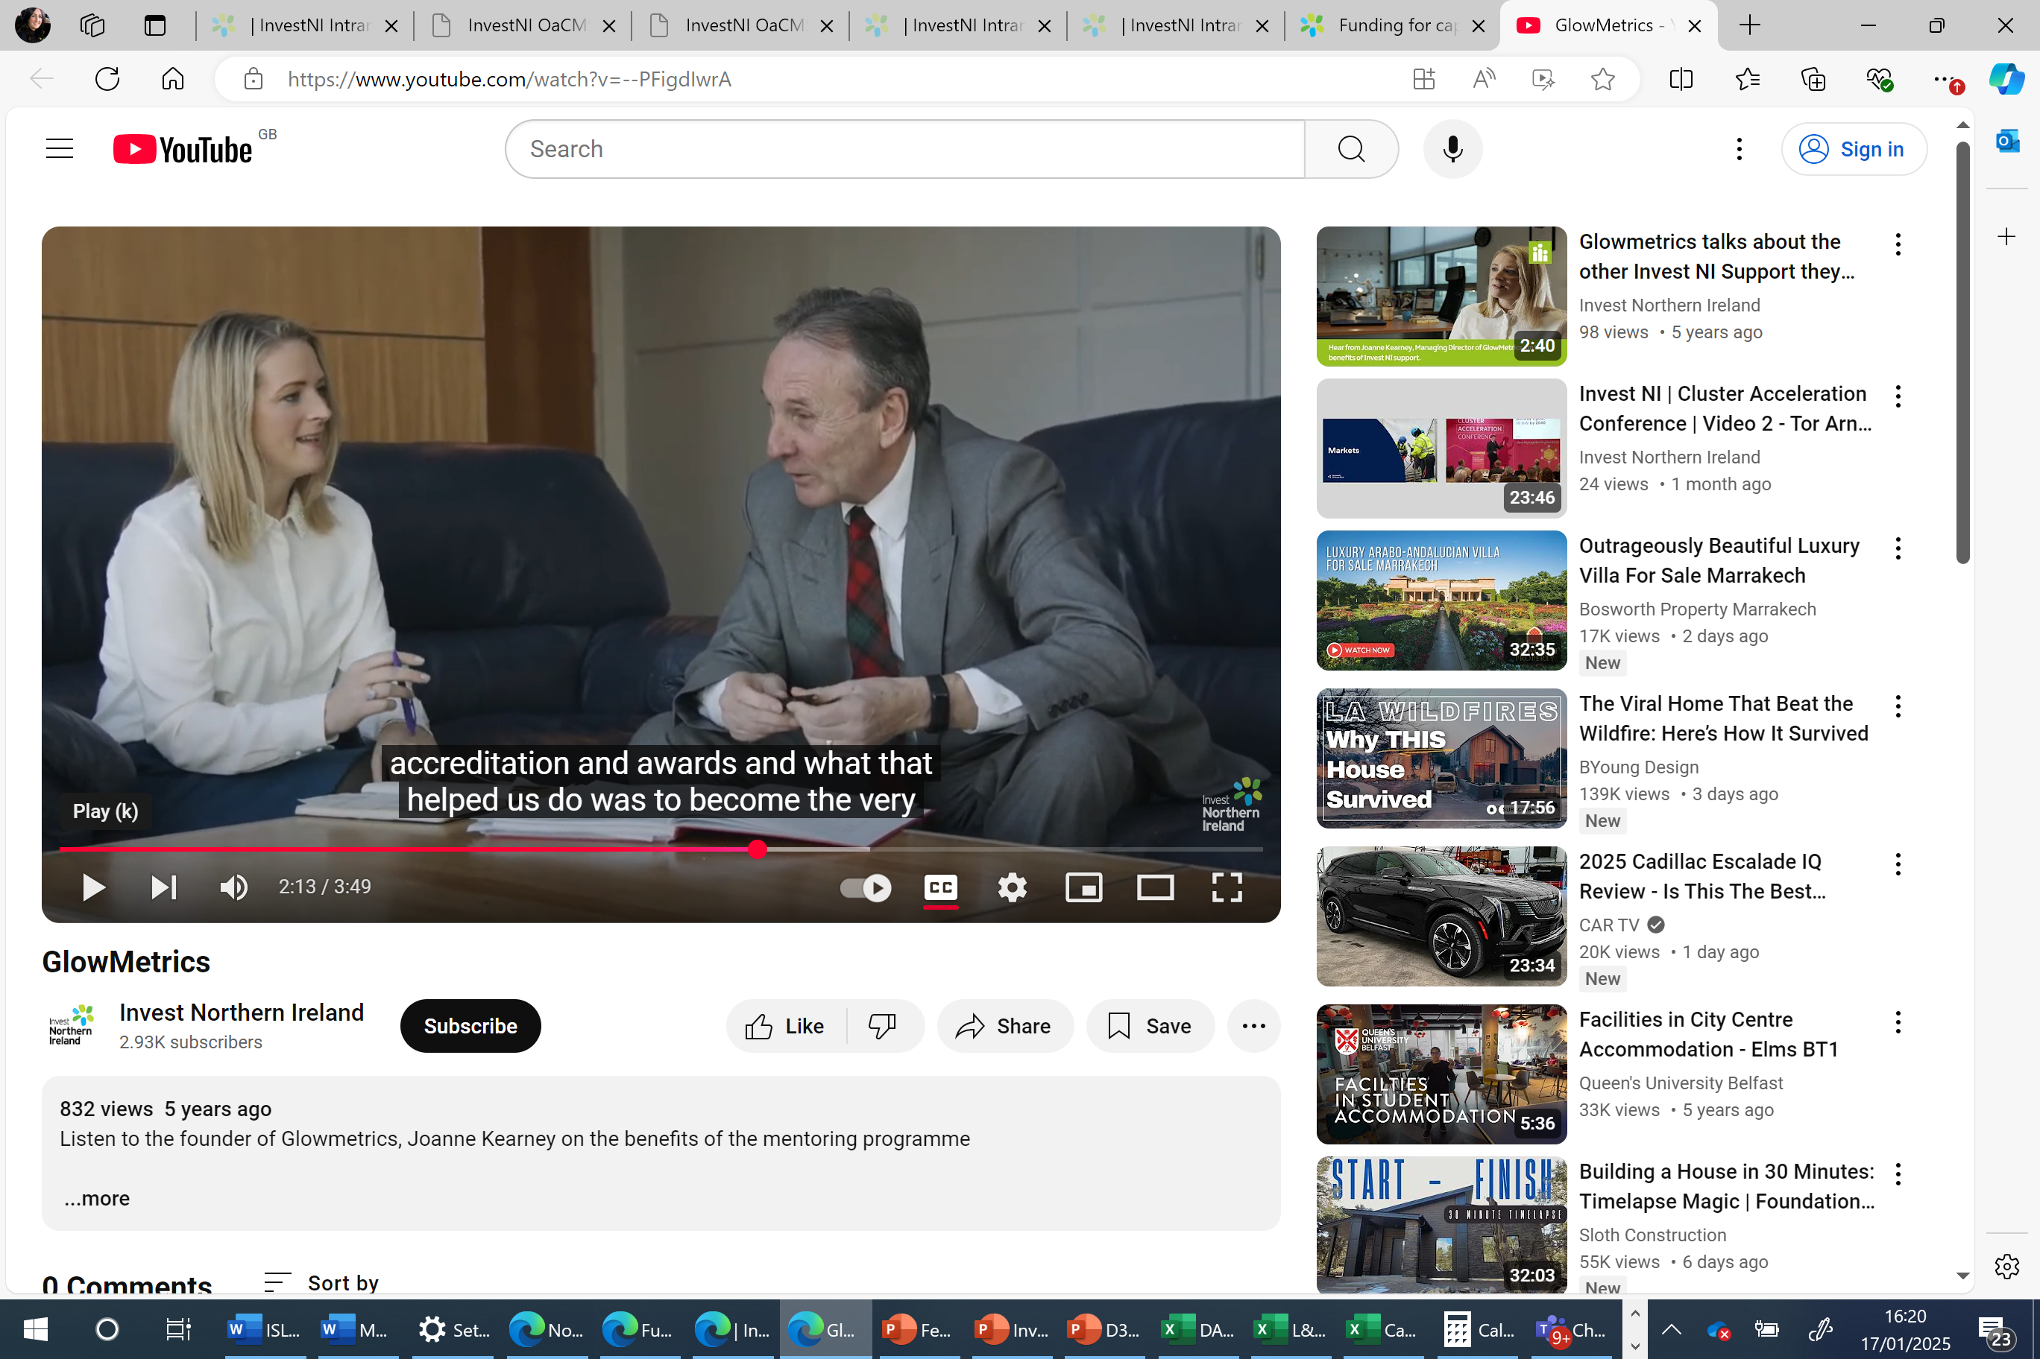
Specialist Mentoring Support
Tailored 1-2-1 mentoring service
Specialist skills and experience
Available as part of structured programmes or as focused projects
Invest NI mentoring framework has a wide international reach and sector expertise
Up to £4000K support (49%)
Notes:
Phil is looking after the Mentor programme which offers up to £4k of grant support for a specialist mentor to complete a project within 12 months in a company. This can range from finance, systems, marketing plans etc

Slide 46
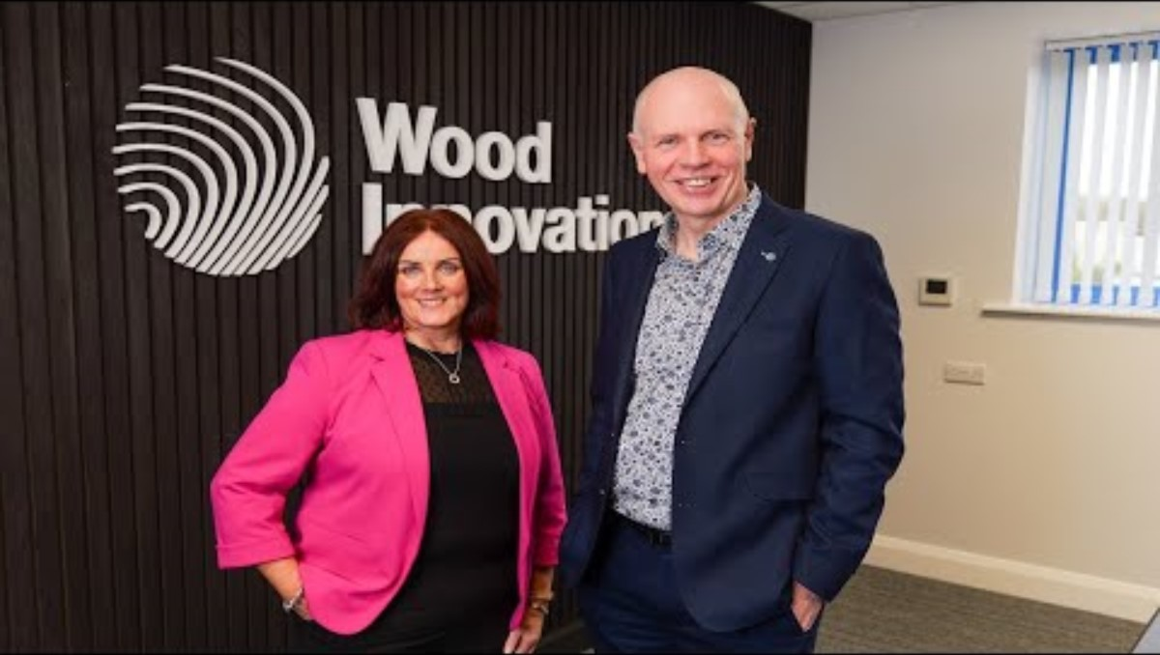
Non-Executive Director Support
A specialist Non-Exec Director can help
Enhance strategic focus and decision-making
Developing and executing business vision and strategy
Strengthening corporate governance and risk management
Developing a board and elevating executive accountability
Driving business growth, scaling, and change management
Expanding into new markets and increasing export sales
Financial support up to £10,000 or 49% of eligible costs
A two-year engagement, typically 12-24 days per annum

Slide 47
2026 Programme Journey –
Top teams of growth companies
10mth blended programme ( 2 cohorts launching this year)
Combines World Class Executive Education Workshops, Top Team Coaching, Facilitated Peer Learning Sessions
International CEO Module in partnership with Porto Business School

Slide 48
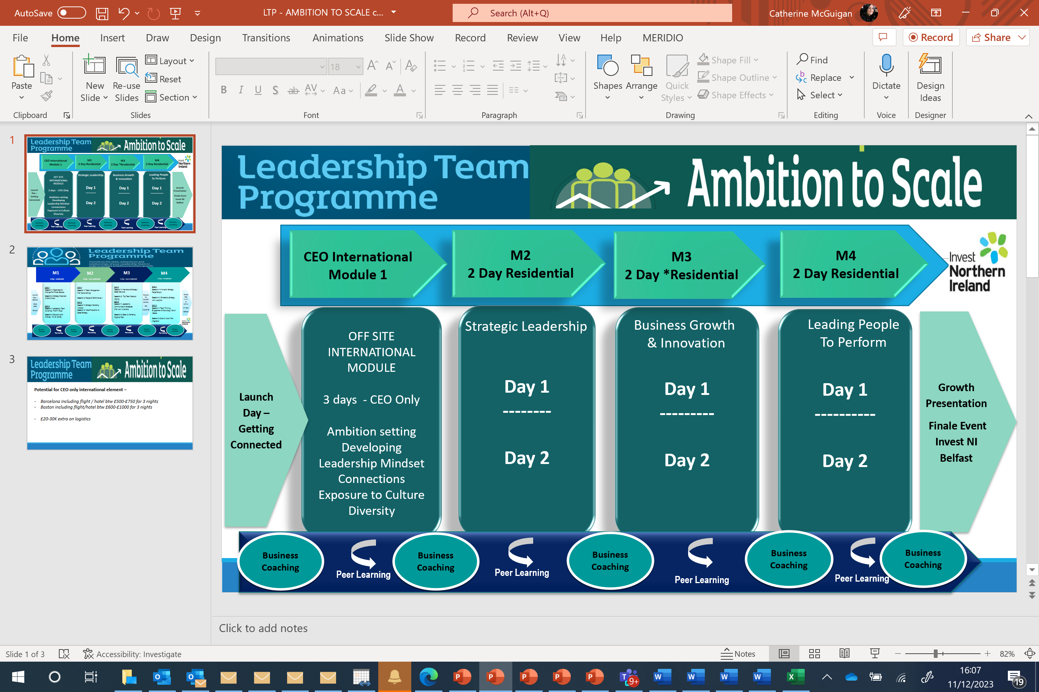









COHORT 5 LEADERSHIP TEAM : AMBITION TO SCALE PROGRAMME (2027)
Programme Launch
Getting Connected
Future Leadership Guest Speaker
27th Jan 26
MODULE 1
2 Day Team **Residential**
10th & 11th March 2027
MODULE 2
3 Day International CEO Module Porto Business w/c 19th April 2027
MODULE 3
2 Day of Top Team Workshops (non residential)
26th & 27th May
MODULE 4
2 Day Team **Residential**
23rd & 24th September
Finale Growth Presentation Event
Wednesday 20th October (or Wed 3rd Nov) 2027
Belfast
10 months programme journey
INPUTS
Leadership Capability and MBTI Assessment
Business Diagnostic
Transformation & Scaling
Strategy Diagnosis & Growth Roadmap
Visionary Leadership & Purpose
Driving Innovation, AI and Value Creation
OUTPUTS
Leadership Reflective Journal
Business Growth Plan
PEOPLE & CULTURE
LEADERSHIP & STRATEGY
BUSINESS GROWTH
& SCALING
Strategic Leadership & Engagement
Leading Strategy & Innovation
Peer Learning Sets
Leading Change and Thriving Leadership
Leadership Communication, Top Team Development
Assessing International Opportunities & Culture
International Growth Insights
CEO Panel
Growth Strategy Execution & KPI’s
Optional Extra. Masterclasses – Talent, Innovation, Engagement, Skills, Operational Excellence, Supply Chain, Clusters
EXECUTIVE TEAM COACHING
PEER NETWORKING SETS : Session 1 - April , Session 2 - June, Session 3 – September
Online Learning Portal
ONLINE LEARNING PLATFORM

Slide 49
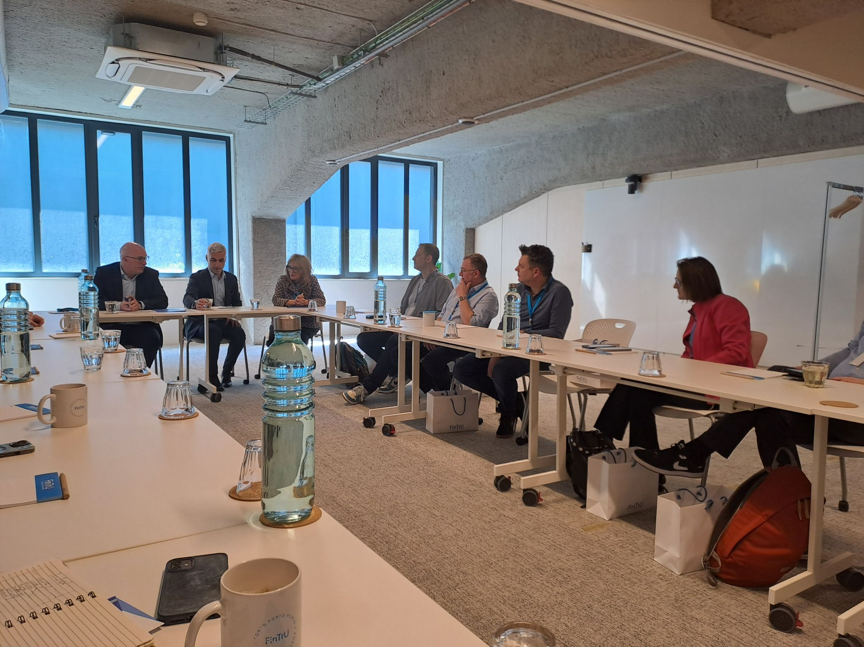


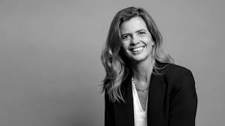
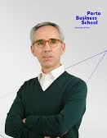
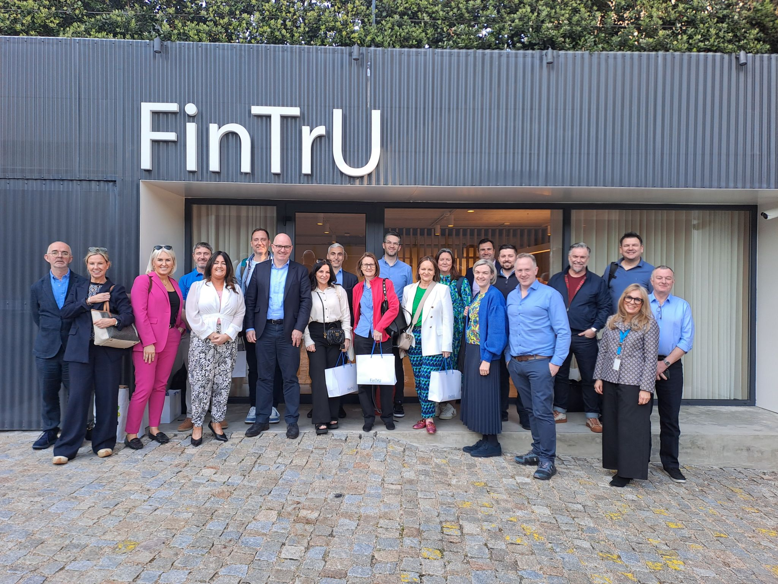



Slide 50
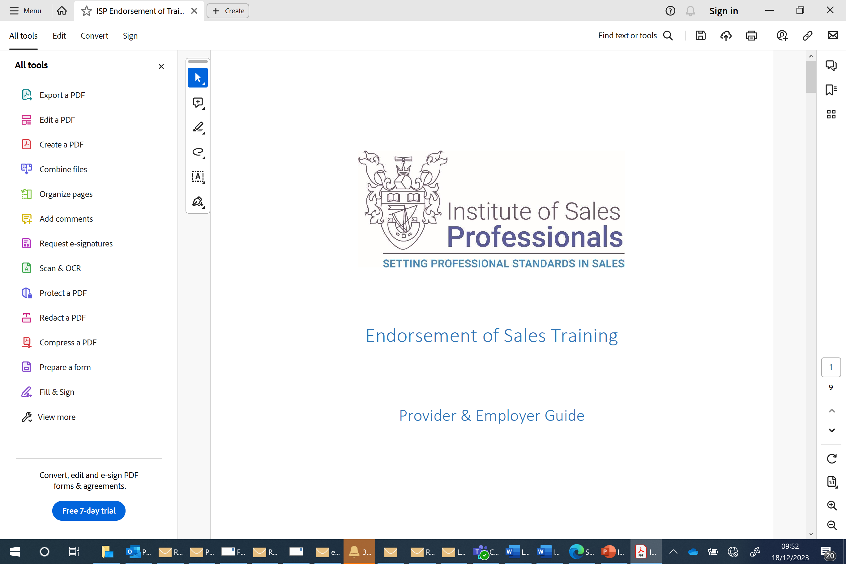
International Sales Leadership Programme
For Sales or Commercial Directors of £5M+ Companies
Wanting to develop strategic leadership capability and drive international sales growth
Blended 10mth Programme - Combining Peer Workshops, Specialist Mentoring, Leadership Coaching
ISP Endorsed

Slide 51

International Sales Leadership Programme
Commercial /Sales Director of Growth clients with >£5M and scaling potential
Professional Selling / Negotiations / Psychology of Sales Performance
---------------------
LAUNCH SESSION
Coach Initiation – completion of leadership diagnostics, initial 1-2-1
Mentor Initiation– completion of sales diagnostics and kick off
*Residential *
Session 3
Peer Learning Session 1 – May 2025
*Residential *
Session 1
International Sales Strategy – Diagnosis & Development
---------------------
SALES
TRAINING
Psychology of
Sales & Influence
Sales Pitch Optimisation
Growth Finale
INTERNATIONAL SALES
GROWTH PLAN PRESENTATION
Panel
INVEST NI
Session 4
International Culture and Future Trends
Peer Learning Session 1 – August 2025
Session 2
Sales Playbook & Lead Generation
Session 5
AI & Innovation
High Performance
& Wellbeing
Peer Learning Session 1 October 2026
1-2-1 Business (International Sales Focus) Mentoring (Up to 5 days) – Focus on Sales Strategy Development and Execution
1-2-1 Sales Leadership Coaching (Up to 3 days) – Focus on Capability Development & People Enablers

Slide 52
Recruitment Dates
PROGRAMME | RECRUITMENT OPEN | REFERRALS | LAUNCHES | SUPPORT AVAILABLE
LEADER PROGRAMME | RECRUITMENT STARTS OCTOBER 2026 OPEN NOW FOR REFERRALS – ‘RDS LEADER PROGRAMME’ |  | Autumn 2026 *15 PLACES | 49% SUPPORT TOWARDS COACHING/MENTORING, 100% TOWARDS OF WORKSHOPS (DM)
LEADING WITHIN A GROUP | RECRUITMENT STARTS OCTOBER 2026 OPEN NOW FOR REFERRALS – ‘RDS LEADING WITHIN A GROUP’ |  | Feb 2027 *10 PLACES* | 49% SUPPORT TOWARDS EXECUTIVE EDUCATION, COACHING AND PEER NETWORKING
LEADERSHIP TEAM – AMBITION TO SCALE COHORT 4 | RECRTUIMENT STARTS SEPTEMBER 2026 |  | Jan 2027 *15 TOP TEAM PLACES* | 50-70% SUPPORT TOWARDS EXECUTIVE EDUCATION,INTERNATIONAL MODULE, COACHING AND PEER NETWORKING FEE
INTERNATIONAL SALES LEADERSHIP PROGRAMME | Spring 2027– 12 places |  |  | 49% SUPPORT TOWARDS COACHING/MENTORING, 100% TOWARDS OF WORKSHOPS (DM)
MENTORING / NED | CURRENTLY OPEN FOR REFERRALS – CDS MENTORING OR NED |  |  | 49% support up to £4K max (Mentoring) or £10K max (NED)

Slide 53

Skills SUPPORT
Katie Deveney
Apprenticeship Policy and Strategic Engagement
Department for the Economy

Slide 54

DfE Apprenticeship Programmes
Skills to Propel – Building Stronger Leaders, Building Stronger Business

Slide 55
DfE Apprenticeship NI Programme
and
Higher Level Apprenticeship Programme
The Department supports the funding and delivery of the Apprenticeship NI programme, which provide formal vocational qualifications at Levels 2 and 3 in Northern Ireland.
Higher Level Apprenticeships are delivered in partnership with higher education (HE) institutions.

Slide 56

Apprenticeship NI frameworks
Over 120 Frameworks currently available on Apprenticeship NI programmes from Level 2 onwards.
Specifically focusing on Leadership and Management courses,
Level 2 – Team Leading (entry to join L3)
Level 3 – Management
Level 5 – Business (BMC), Business Management (NRC), Business and Enterprise (NWC)

Slide 57
Eligibility and entry to the programme
Employment status
You must be a new employee or have been employed by your current employer for less than six months.
Entry requirements
Private Training Employers, colleges and employers may apply their own entry criteria. (Dependent on course content and area)
Support for successful completion
Employers and training contractors must ensure learners have the potential and opportunity to complete the apprenticeship successfully.

Slide 58
Apprenticeship participation and investment
APPRENTICESHIPSNI PARTICIPATION
ANNUAL DEPARTMENTAL INVESTMENT
12,274
Around £50m (annual)
participants in April 2026
for the off-the-job training
element of apprenticeships
Up from 7,456 in April 2020
Employer-led and demand-driven
Employers create apprenticeship opportunities in response to workforce needs.
Source: figures supplied by the user. Participation comparison: April 2020 and April 2026.

Slide 59
Employer incentives
Completion incentive payments (AppsNI)
£670 to £2,008
The Department provides incentive payments to encourage employer participation when apprentices successfully complete their apprenticeship.
Payment amounts depend on the occupational area.
National Insurance contribution relief
Some eligible employers may benefit from relief from Class 1 National Insurance contributions for apprentices under the age of 25.

Slide 60
Skills Focus Funding for Employers
Tailored skills through the six FE colleges
FE colleges work with SMEs with fewer than 250 employees to tailor workforce training and support lifelong learning. Qualifications range from Level 2 to Level 7 (equivalent to a Master’s degree).
90% Department funding, 10% employer contribution
The Department funds 90% of the qualification cost. Employers contribute 10%.
Flexible delivery for Leadership and Management
Learning can take place in a classroom, at the employer’s premises or online with a tutor. Groups can include employees from one company or several businesses. Flexible delivery, including blended online training, works especially well for Leadership and Management qualifications.
Notes:
Source: Programme information supplied by the user on 14 October 2026.
Skills Focus supports collaboration between businesses and the six FE colleges to provide tailored skills training for SMEs with fewer than 250 employees. Qualifications span Level 2 through Level 7, equivalent to Master’s degree level, and contribute to lifelong learning for people in employment.
The Department funds 90% of the qualification cost and employers contribute 10%.
Delivery can be classroom based, on site at the employer’s premises or tutor-led online. Groups may combine employees from several businesses or multiple employees from a single company. Flexible delivery and blended online training work especially well for Leadership and Management qualifications.

Slide 61
Appetite for apprenticeships across NI
Strong and sustained demand
Employers and individuals across Northern Ireland continue to show strong demand for traditional-type apprenticeships.
Uptake in CCGBC
Apprenticeship uptake and participant numbers in CCGBC have traditionally been low.
Supporting increased participation
We want to support CCGBC to increase uptake and improve this trend. Good jobs and Regional Balance are a ministerial priority.

Slide 62
NI Apprenticeship Week
NIAW remains one of the Department’s largest week-long engagement activities.
Free and accessible participation
759,780
In-person and online activities give , employers, school leavers and parents opportunity to participate.
Adult social media reach
Delivery depends on sustained staff capacity
APSE plan and coordinate activity, manage relationships with colleges, training providers, schools and employers, maintain consistent messaging and respond to stakeholders.

Slide 63
Sectoral Partnerships
Sectoral Partnerships bring together employers, further education providers and industry experts to shape apprenticeship qualifications and curriculum frameworks at Levels 2 and 3.
Partnerships review or develop apprenticeship frameworks when sectors identify training gaps, qualifications change, government introduces policy or working practices advance. This keeps frameworks aligned with changing industry requirements.

Slide 64
Apprenticeship Week runs 1–5 February 2027
NORTHERN IRELAND APPRENTICESHIP WEEK 2027
1–5 FEB
CONFIRMED WEEK DATES
Northern Ireland Apprenticeship Week 2027 runs Monday 1 to Friday 5 February.
We hold monthly RWG meetings to support and align both delivery and co-ordination.
2027 • Monday to Friday
Immediate action: align partner activity and external promotion to 1–5 February 2027.
Source: Week dates supplied for this update. Status 7 September 2026.

Slide 65
Citizen Space is live — event submissions close 8 January
NIAW2027 EVENT SUBMISSIONS
A clear hand-off to event hosts to NI Direct publishing
LIVE NOW
FRI 8 JAN 2027
MON 11 JAN 2027
1–5 FEB 2027
Citizen Space
Submissions close
NI Direct publishing
Apprenticeship Week
Event form open
Final event details due
Events can be published
Campaign goes live
Action for event hosts: submit complete event information through Citizen Space by Friday 8 January 2027.
Operational dates supplied for this update. Status 7 September 2026.

Slide 66
NI Apprenticeship Awards
Annual competition and awards ceremony
The Department holds the Northern Ireland Apprenticeship Awards (NIAA) each year.
Recognising achievement
The competition recognises talent, achievement and good practice in apprenticeship delivery.
A cost-effective, high-profile platform
The Department delivers NIAA within available budgets.

Slide 67
Three milestones frame the 2027 Apprenticeship Awards
NORTHERN IRELAND APPRENTICESHIP AWARDS 2027
A confirmed timetable from launch to ceremony
01 SEP 2026
23 OCT 2026
25 FEB 2027
Awards launched
Nominations close
Awards ceremony
Nominations opened
12 noon
Stormont
Next milestone: nominations close at 12 noon on 23 October 2026.
Sources: Department for the Economy; NI Business Info. Status 7 September 2026.

Slide 68
Summary: skills and participation
More people are gaining qualifications, fewer have low or no qualifications, and appetite for lifelong learning is growing.
64%
More than 70%
increase in apprenticeship starts
since 2019/20
growth in traineeship participation
in the last year
These figures represent thousands of people gaining skills, building careers and contributing to our economy.

Slide 69
Summary: future opportunities
Opportunities for innovation.
Opportunities for growth.
Opportunities to build a workforce that is adaptable, skilled and ready for the future.

Slide 70
Thanks for asking us along and we will be here after to chat and help support any of you interested in the apprenticeship model.

Slide 71
OTHER Skills Support
Personal Learning Account Fund
Skills Focus
InnovateUs
Traineeships
Skills for Life and Work
Job Start Programme
Work Experience Programme
JBO Adviser Discretion Fund

Slide 72

Personal Learning Account
Over 2,000 applications to date with 1,400 approved for funding
Up to £500 to help someone upskill and find employment or progress in their career
For those self employed must enable them to gain more income by offering more services
Must be transformative – not just general CPD or upskilling
100% funded (up to £500)
Courses or funding must not be available through other programmes
Application made via CCG Grants and Funding Unit
Closed currently but set to reopen in April 2027

Slide 73
 | What is it? | Who is it for? | How do I find out more? | Support Organisations
Skills Focus | Tailored training for small to medium-sized businesses to increase the skills levels of their existing workforce. | for small to medium-sized businesses in NI with fewer than 250 employees. | Speak to the colleges today or on the nibusinessinfo.co.uk website | Northern Ireland Regional Colleges Department for the Economy (DfE)
Innovate Us | Fully funded training for small businesses to undertake innovation activity and drive growth | Employers and businesses in Northern Ireland with fewer than 50 employees. | Speak to the colleges today or on the nibusinessinfo.co.uk website | Northern Ireland Regional Colleges Department for the Economy (DfE)

Slide 74
 | What is it? | Who is it for? | How do I find out more? | Support Organisations
Traineeships | Traineeships allow you to nurture the next generation, helping your business to develop a loyal, talented workforce. | Any employer in NI that holds Employer and Public Liability Insurance. (Traineeships are open to unemployed only). | Speak to the colleges today or on the nibusinessinfo.co.uk website | Northern Ireland Regional Colleges Department for the Economy (DfE)
Skills for Life and Work | A training programme for young people who want to develop their skills and get ready for work. | Any size business in NI. (Participants are young people needing experience). | Email DFE on skillsforlifeandwork@economy-ni.gov.uk or on the nibusinessinfo.co.uk website | Department for the Economy (DfE) Youth Inclusion Branch

Slide 75
 | What is it? | Who is it for? | How do I find out more? | Support Organisations
Work Experience Programme | The Work Experience Programme offers short work experience placements with local employers. | Any employer in NI. (Participants are to 16-65 year olds who are unemployed or in receipt of benefits.) | Speak to your local Jobs and Benefits Office Employer Advisors or on the nibusinessinfo.co.uk website | Department for Communities
JBO Adviser Discretion Fund | It is a non-repayable grant award of up to £1,500 used to remove a barrier to employment. | Those receiving benefits can speak to their work coach about eligibility. Case by case basis. | Speak to your local Jobs and Benefits Office Work Coach. | Department for Communities

Slide 76
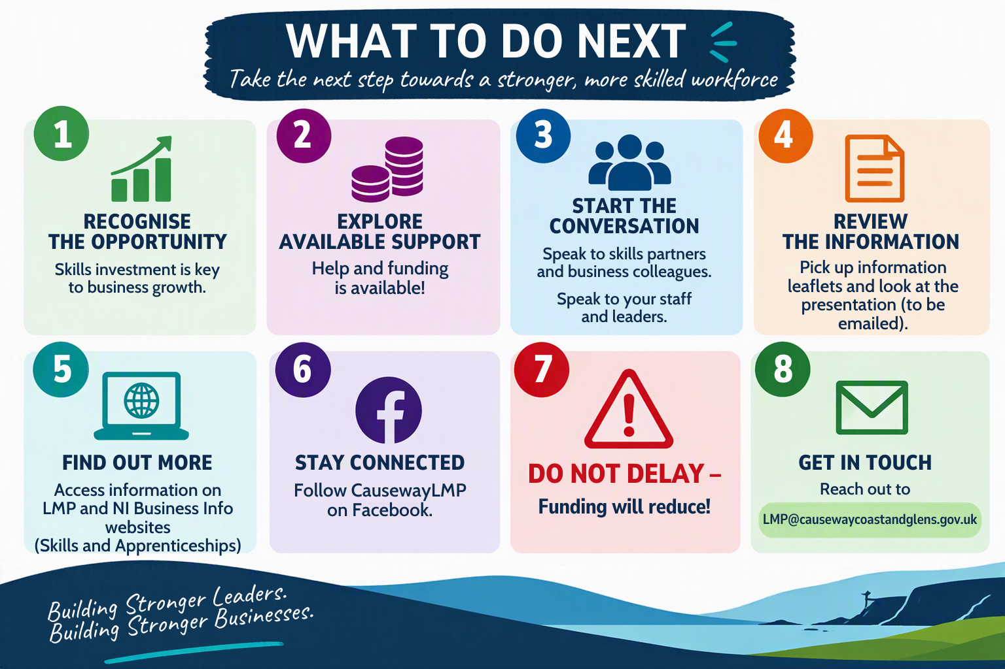

Slide 77
ANY Questions?

Slide 78

Thank you!

